Slide 1
How to predict discriminability of phonemic length contrasts:
Categorization and perceptual similarity of Finnish length by Japanese and American English listeners
Ryan Lidster¹, Franziska Kruger¹, Danielle Daidone¹,
Lila Michaels¹, & Aaron Albin²
¹Indiana University and ²Kobe University
New Sounds, Waseda University, Tokyo, August 30, 2019

Slide 2
Segmental bias in models
Non-native/L2 speech perception models focus (almost exclusively) on segmental perception:
  SLM (Flege, 1995)
  PAM (Best, 1995)
  PAM-L2 (Best & Tyler, 2007)
  L2LP (Escudero, 2005)
As a result, perception tasks used to predict learners’ difficulties with L2 contrasts were originally designed for segmentals
  Example: Perceptual Assimilation Task was created to examine the assimilation of non-native consonants and vowels to L1 categories

Slide 3
Phonemic length
Finnish has phonemic length for both vowels and consonants:
tuli 'fire’ vs. tuuli 'wind’ vs. tulli 'customs’
How do we predict the extent of naïve listeners' difficulties in perceiving various such length contrasts?
  Important for pedagogy in deciding what to focus on and how
  Important for theory in understanding how length perception is affected by listeners’ L1
In particular, present study compares these two groups:
  L1 Japanese listeners: Also has L1 phonemic length
  L1 American English (AE) listeners: No L1 phonemic length

Slide 4



Length in Finnish, Japanese, and English
 | Finnish | Japanese | English
cVcV
cVVcV
cVccV
cVcVV
cVVcVV
cVccVV
cVVccV
cVVccVV
Clearly, there should
be a difference.
But how to predict it?

Slide 5
Proposed task 1: Identification
Traditional Perceptual Assimilation task:
  So and Best (2008) investigated assimilation of tones (still related to L1 prosodic categories)
  Interpret in terms of categorization of non-native sounds to L1 sounds
But if the labels are transparent enough to be usable even for listeners without phonemic length in their L1...
  …an identification task can be implemented and analyzed in the same way as a Perceptual Assimilation task
  Use Overlap Scores to calculate overlap between non-native categories (Levy 2009)

Slide 6
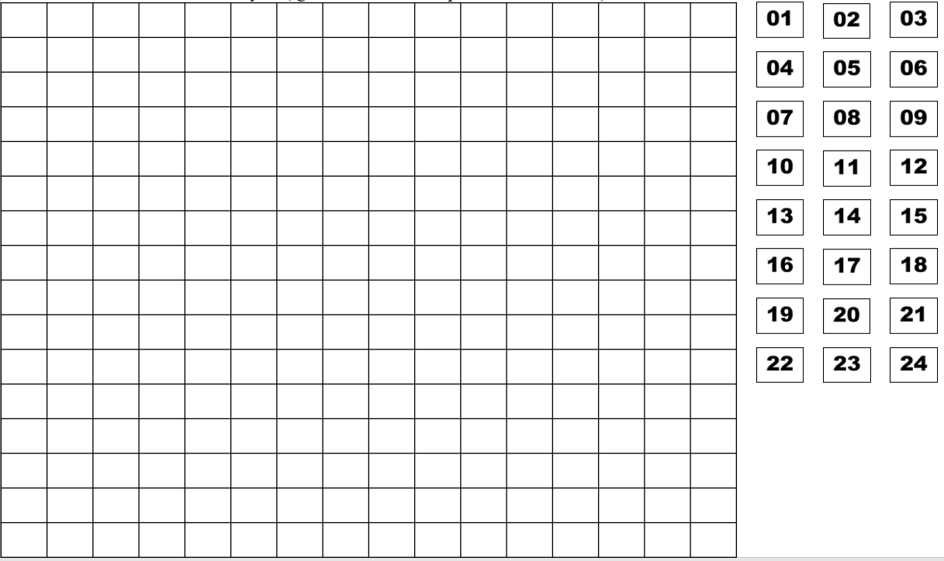
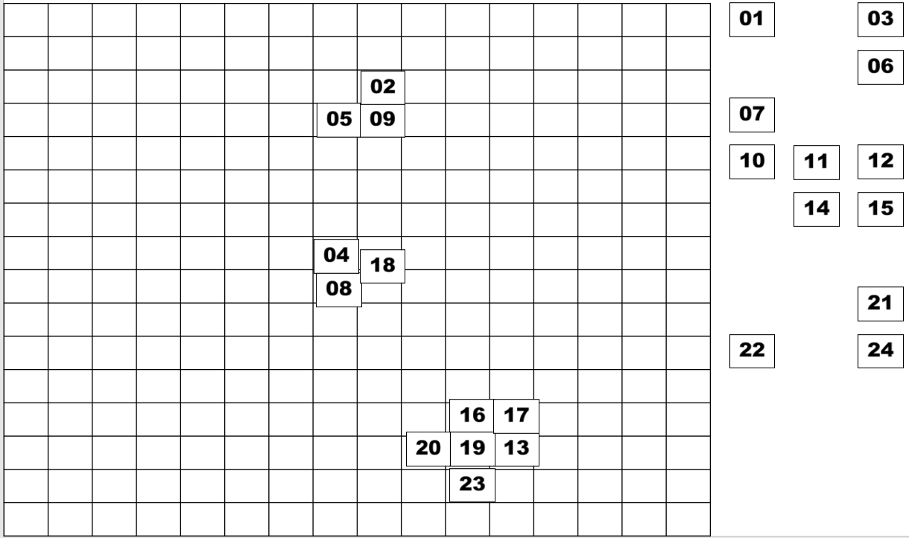
Proposed task 2: Free classification
One type of similarity judgment task
Originally used in dialectal and accent perception
  e.g., Atagi & Bent, 2013; Clopper, 2008
More recently extended to perception of L2 segments
  Daidone, Kruger, & Lidster, 2015
Because participants make groups without labels,
it can be used for participants with or without the
relevant L1 categories

Slide 7
Research question
How well do Identification and Free Classification tasks predict the discriminability of Finnish length contrasts (as measured with an Oddity Task)?
Length Discrimination (Oddity Task)
Free Classification Task
Identification Task

Slide 8
Participants
  Other exclusion criteria:
    Heritage speaker of another language
    Parents other L1
    Studied any languages with length (for AE group)
    Studied phonetics/ phonology
    Speech/hearing disorder
    Failed the hearing screening
    Failed identification training
    > 5% Timeouts on the discrimination task
28 L1 American English listeners
All naïve listeners:
No participant in either group had knowledge of Finnish
29 L1 Japanese listeners

Slide 9
Procedure
Consent Form
Hearing Screening
Free Classification
Oddity Discrimination Task
Language Background Questionnaire
Identification Task

Slide 10
Methods and Results
Identification
Free Classification
Oddity
Inter-Task Correlations

Slide 11
Identification

Slide 12
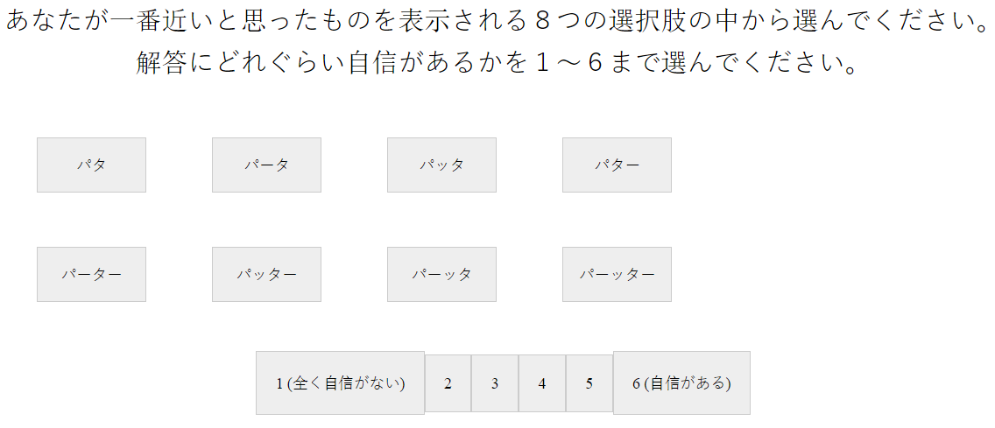
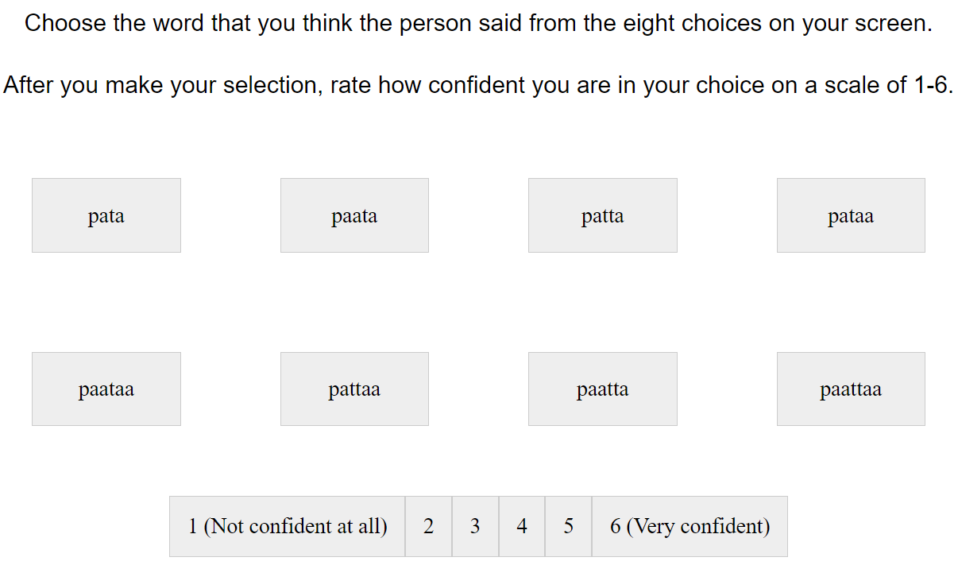
Identification Task
3 female speakers x 8 length templates x 3 contexts
Blocked by context (pata, tiki, kupu)
Completed a training with a male voice with all 8 possible choices in order before each block
Long segments represented with doubled letters for English participants
Options in katakana for Japanese participants

Slide 13
Results: Identification for Japanese listeners
 |  | Response
 |  | pata | paata | patta | pataa | paataa | pattaa | paatta | paattaa
Stimulus | pata | 90.8 | 0.0 | 7.2 | 1.9 | 0.0 | 0.0 | 0.0 | 0.0
 | paata | 0.0 | 76.8 | 0.0 | 0.0 | 1.0 | 0.0 | 21.3 | 1.0
 | patta | 1.4 | 0.0 | 98.1 | 0.0 | 0.0 | 0.0 | 0.5 | 0.0
 | pataa | 0.0 | 0.5 | 0.0 | 95.2 | 1.0 | 3.4 | 0.0 | 0.0
 | paataa | 0.5 | 0.5 | 0.0 | 1.0 | 96.1 | 0.0 | 0.0 | 1.9
 | pattaa | 0.0 | 0.0 | 1.0 | 0.5 | 0.0 | 93.2 | 0.0 | 5.3
 | paatta | 0.5 | 20.8 | 0.0 | 0.0 | 1.0 | 0.5 | 75.8 | 1.4
 | paattaa | 0.0 | 1.0 | 0.0 | 1.0 | 67.1 | 1.9 | 0.0 | 29.0
5% or less in gray,
modal response in bold and shaded

Slide 14
Results: Identification for AE listeners
 |  | Response
 |  | pata | paata | patta | pataa | paataa | pattaa | paatta | paattaa
Stimulus | pata | 76.6 | 5.2 | 10.3 | 2.8 | 2.4 | 1.2 | 0.8 | 0.8
 | paata | 2.8 | 45.2 | 2.8 | 2.8 | 12.7 | 3.2 | 27.4 | 3.2
 | patta | 19.0 | 11.9 | 45.2 | 8.7 | 3.2 | 4.8 | 7.1 | 0.0
 | pataa | 13.9 | 5.2 | 5.2 | 41.3 | 7.1 | 19.8 | 4.0 | 3.6
 | paataa | 1.2 | 8.3 | 1.6 | 2.4 | 40.5 | 4.8 | 6.7 | 34.5
 | pattaa | 1.6 | 8.7 | 10.3 | 21.0 | 3.6 | 47.2 | 4.4 | 3.2
 | paatta | 2.4 | 45.2 | 6.3 | 4.8 | 6.0 | 5.2 | 28.2 | 2.0
 | paattaa | 1.6 | 15.1 | 7.1 | 7.1 | 29.8 | 8.7 | 12.7 | 17.9
5% or less in gray,
modal response in bold and shaded

Slide 15
Calculating Overlap Scores (Levy, 2009)
 |  | Response
 |  | pata | paata | patta | pataa | paataa | pattaa | paattaa | paattaa
Stimulus | pata | 76.6 | 5.2 | 10.3 | 2.8 | 2.4 | 1.2 | 0.8 | 0.8
 | paata | 2.8 | 45.2 | 2.8 | 2.8 | 12.7 | 3.2 | 27.4 | 3.2
Example: AE listeners’ perception of pata~paata
How similarly were length templates categorized overall
→ 2.8 + 5.2 + 2.8
+ … = 18.7%

Slide 16
Results: Overlap Scores for AE listeners
 |  | Stimulus
 |  | pata | paata | patta | pataa | paataa | pattaa | paatta | paattaa
Stimulus | pata
 | paata | 18.7
 | patta
 | pataa
 | paataa
 | pattaa
 | paatta
 | paattaa
Prediction: pata~paata will be easiest (18.7% overlap)
paata~paatta will be hardest (91.7% overlap)

Slide 17
Results: Overlap Scores for Japanese listeners
 |  | Stimulus
 |  | pata | paata | patta | pataa | paataa | pattaa | paatta | paattaa
Stimulus | pata
 | paata
 | patta
 | pataa
 | paataa
 | pattaa
 | paatta
 | paattaa
Prediction: pata~paata will be easiest (0.0% overlap)
paataa~paattaa will be hardest (70.5% overlap)

Slide 18
Free Classification

Slide 19
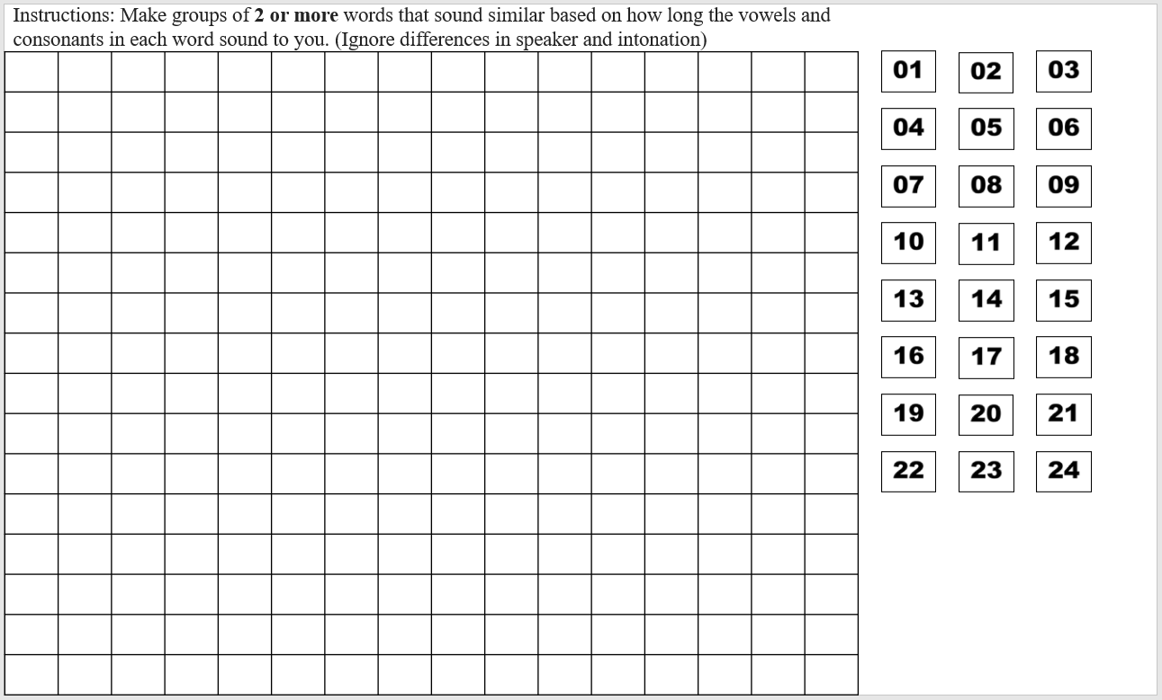
Free Classification
8 length templates (pata, paata, patta, pataa, paataa, pattaa, paatta, paattaa)
3 female voices
3 contexts (pata, tiki, kupu), 1 per slide

Slide 20
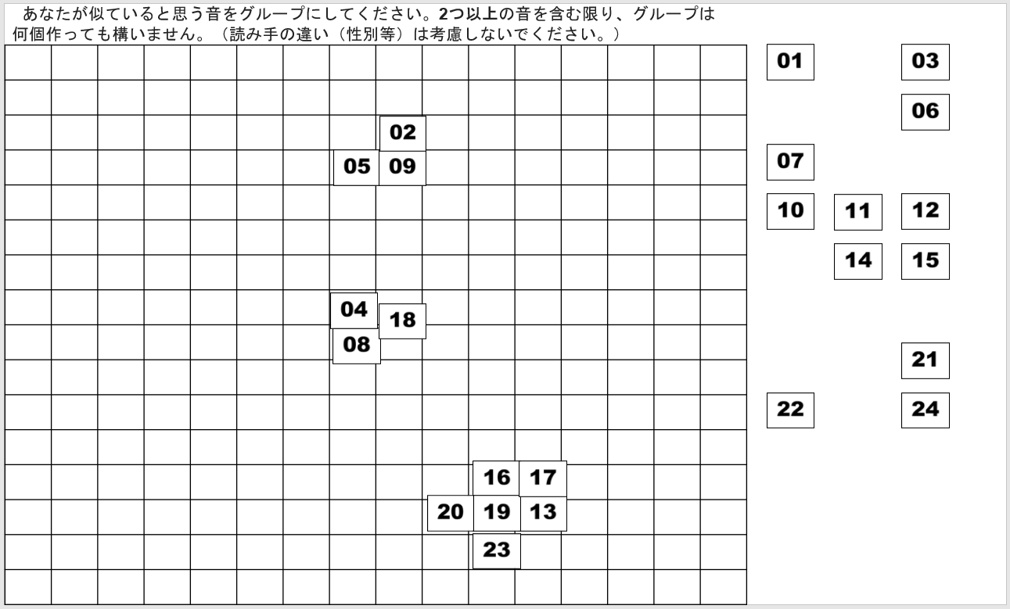
Free Classification

Slide 21
Results: Free Classification (JP listeners)
cVcV & cVVcV tokens grouped together 1.4% of the time by Japanese listeners

Slide 22
Results: Free Classification (JP listeners)
Prediction: pata~paata will be easiest (grouped 1.4% of the time)
paataa~paattaa will be hardest (grouped 57.5% of the time)
paata~paatta will be 2nd hardest (grouped 51.2% of the time)

Slide 23
Results: Free Classification (AE listeners)
Prediction: pata~paata will be easiest (grouped 1.4% of the time)
patta~pata will be 2nd hardest (grouped 35.4% of the time)
paata~paatta will be hardest (grouped 35.6% of the time)

Slide 24
Results: Free Classification
Multidimensional Scaling (MDS) visualizes distances between stimuli
Best model recreation of observed distances
  Ex: X and Y grouped together 90% of the time
1 dimension is not sufficient, but 2 dimensions are:
X
.1
Y
cVVcVV
.87
cVccVV
cVVcVV
cVccVV
.85
cVccV
cVccVV
cVccV
cVccV
.88
cVVcVV
cVccVV
cVccV
cVVcVV

Slide 25
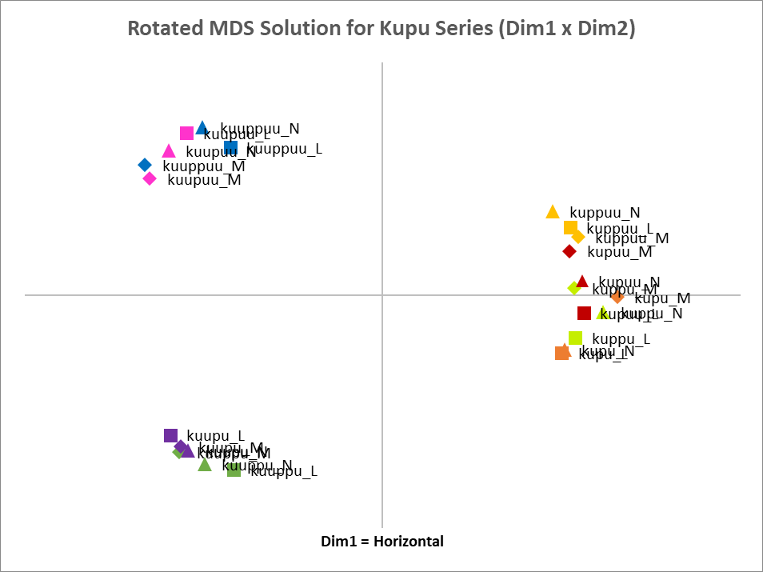
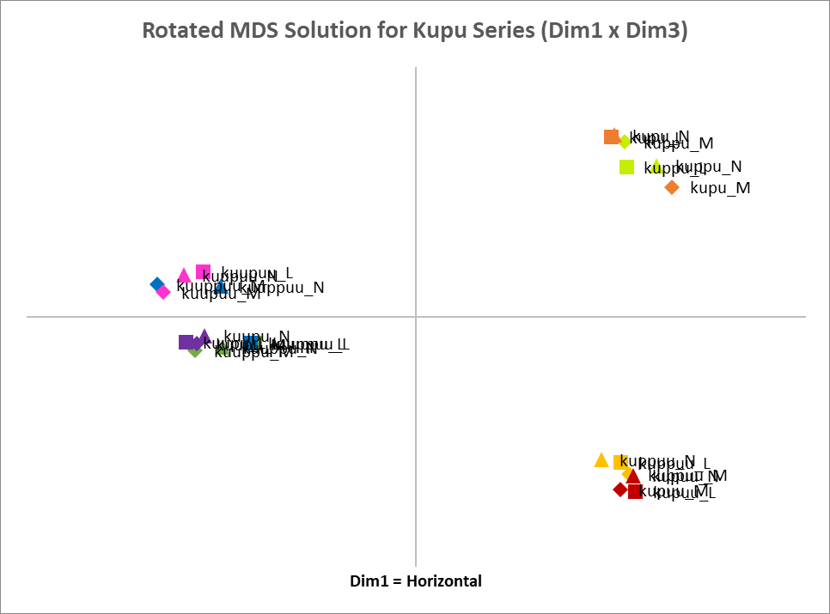
Results: MDS 3D solution for Japanese Listeners
CVCV & CVCCV
CVVCVV & CVVCCVV
CVVCV & CVVCCV
CVCVV & CVCCVV

Slide 26
Results: MDS 3D solution for AE Listeners
Initial vowel is long (with the exception of two kuppu tokens)

Slide 27
Oddity

Slide 28
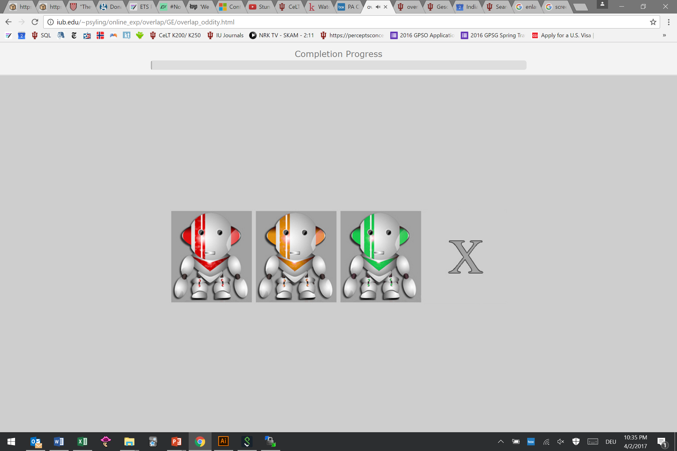
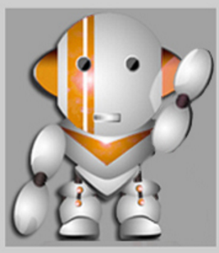
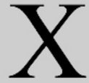

Oddity
Instructions:
  Click on the robot that said something different.
  If all say the same word, click X.
3 female speakers
Conducted online through jsPsych
Finnish length : 8 contrasts
3 contexts: /pata/, /tiki/, /kupu/ (e.g., pata-patta)
1 | cVcV-cVccV | 5 | cVccVV-cVVcVV
2 | cVcV-cVVcV | 6 | cVVcV-cVVccV
3 | cVccV-cVVcV | 7 | cVVcVV-cVVccVV
4 | cVVcV-cVcVV | 8 | cVVccV-cVVccVV
[pata]-[patta]-[pata]
[pata]-[pata]-[pata]

Slide 29
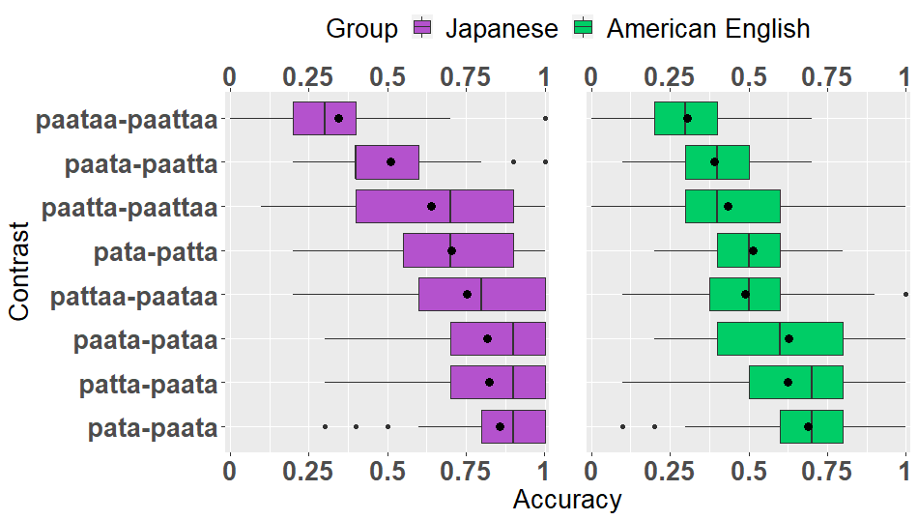
Results: Discrimination (Oddity Accuracy)
Consonant length alone is generally harder
1st vowel length (+ another segment change) is generally easier

Slide 30
Inter-Task Correlations

Slide 31
Japanese Listeners
 | Discrimination |  | Identification | Free Classification
Contrast | Oddity d' | Oddity Accuracy | Overlap Scores | MDS Weighted Distances | Grouping Rates
cVVcVV-cVVccVV | -0.007 | 0.371 | 0.705 | 0.217 | 0.575
cVVcV-cVVccV | 0.642 | 0.511 | 0.440 | 0.287 | 0.512
cVVccV-cVVccVV | 0.779 | 0.613 | 0.039 | 1.998 | 0.155
cVcV-cVccV | 1.013 | 0.697 | 0.087 | 0.959 | 0.213
cVccVV-cVVcVV | 1.085 | 0.741 | 0.024 | 2.805 | 0.041
cVccV-cVVcV | 1.432 | 0.813 | 0.005 | 2.853 | 0.031
cVVcV-cVcVV | 1.594 | 0.790 | 0.014 | 3.081 | 0.023
cVcV-cVVcV | 1.791 | 0.837 | 0.000 | 3.036 | 0.014
Correlation with d’ | -- | 0.969 | -0.858 | 0.868 | -0.888
Most difficult
Easiest

Slide 32
American English Listeners
 | Discrimination |  | Identification | Free Classification
Contrast | Oddity d' | Oddity Accuracy | Overlap Scores | MDS Weighted Distances | Grouping Rates
cVVcVV-cVVccVV | 0.120 | 0.304 | 0.726 | 0.461 | 0.284
cVVcV-cVVccV | 0.482 | 0.390 | 0.917 | 0.559 | 0.356
cVVccV-cVVccVV | 0.664 | 0.435 | 0.536 | 1.806 | 0.198
cVccVV-cVVcVV | 0.847 | 0.490 | 0.294 | 2.057 | 0.130
cVcV-cVccV | 0.938 | 0.513 | 0.417 | 1.165 | 0.354
cVccV-cVVcV | 1.575 | 0.624 | 0.337 | 2.329 | 0.119
cVVcV-cVcVV | 1.726 | 0.629 | 0.310 | 2.686 | 0.019
cVcV-cVVcV | 1.978 | 0.689 | 0.187 | 2.992 | 0.079
Correlation with d’ | -- | 0.992 | -0.813 | 0.912 | -0.750
Most difficult
Easiest

Slide 33
Discussion

Slide 34
Differences between groups
Japanese listeners
  Generally able to discriminate non-native length contrasts
  Difficulties encountered only with forms that are phonotactically marginal (%cVVccV) or illegal (*cVVccVV) in Japanese
  Perceptually repaired these by reducing consonant length
American English listeners
  Struggled in general
  Were near floor on some contrasts

Slide 35
Similarities between groups
Rank order of difficulty was very similar between the two groups
For both groups:
Initial vowel length was easiest
Overall, consonant length was more difficult than vowel length
  Especially difficult when the surrounding vowels were already long
paattaa ~ paataa was harder than paattaa ~ paatta
  i.e. consonant length was harder than even final vowel length

Slide 36
Return to Research Question
How well do Identification and Free Classification tasks predict the discriminability of Finnish length contrasts (as measured with Oddity Task)?
Both Identification and Free Classification tasks were highly correlated with discrimination (r = .75 or higher)
  Thus, both tasks are suitable for examining length perception by listeners both with and without phonemic length in L1
Free classification task in particular does not require category labels or metalanguage
  As such, especially promising for examining the perception of a wide range of non-native phenomena without an L1 equivalent

Slide 37

Thank you!
We would like to thank Prof. Isabelle Darcy and the IU L2 Psycholinguistics Lab for their valuable comments and feedback
Questions? Comments?
rflidste@indiana.edu (Ryan Lidster)

