Slide 1
New Methods for predicting perceptual discriminability of non-native contrasts
Danielle Daidone¹, Ryan Lidster¹, Franziska Kruger¹, and Meg Cychosz²
¹Indiana University and ²University of California, Berkeley
Pronunciation in Second Language Learning & Teaching 2017
9/1/2017

Slide 2
Predicting Non-native Discriminability
Models about the acquisition of L2 phonology predict what sounds are easy/difficult for L2 learners
SLM: Flege, 1995; PAM-L2: Best & Tyler, 2007; L2LP: Escudero, 2005
Predictions are very general
  PAM-L2: two “uncategorized” sounds will be discriminated “poorly to moderately well” depending on similarity to L1 phonemes
  SLM: new category can be established if bilinguals "discern at least some phonetic differences" between L2 sound and closest L1 sound
Need for experimental methods to make more specific predictions
Notes:
Theoretical frameworks address this, but those give big picture hypotheses. For specific contrasts, how do we predict discriminability?
- Need for experimental methods to make specific predictions about how difficult it will be for foreign language learners to discriminate sounds

Slide 3
Perceptual Assimilation (PA) Task
Non-native sounds categorized as L1 sounds and rated as good/bad exemplar
Results typically reported as categorization types:
(Best, 1995; Best & Tyler, 2007)
  Two-category assimilation (2C)
  Category-goodness difference (CG)
  Single-category assimilation (SC)
  Both uncategorized (UC-UC)
  Uncategorized versus categorized (C-UC)
  Nonassimilable (NA)
(Faris, Best, & Tyler, 2016 - subcategories)
Notes:
Listeners categorize non-native sounds as L1 sounds and rate how good of an example it is of that native sound
Relationship of non-native to native sounds typically reported as categorization types (Best, 1995; Best & Tyler, 2007):
Uncategorized = where one or more non-native sounds were not categorized consistently enough as one L1 sound to meet some threshold

Slide 4
Limitations of Perceptual Assimilation Tasks
Cutoff thresholds for "categorized" differ:
  50%, 70%, 90% (Faris et al., 2016, Tyler et al., 2014, Harnsberger, 2001)
Relative difficulty of different categorization types is hard to predict (Best, 1995):
  Uncategorized-Categorized: “very good”
  Category-goodness: “moderate to very good”
  Nonassimilable: “good to very good”

Slide 5
Alternative Analysis: Overlap Scores
Overlap scores compare non-native sounds to each other (Levy, 2009):
  How often two non-native phonemes are categorized as the same native categories
  The greater the overlap, the more difficult the contrast
  Does not take goodness ratings into account

Slide 6
Similarity Judgment Tasks
Listeners hear pairs of sounds, decide on Likert scale how (dis)similar sounds are to each other
Generally analyzed as average (dis)similarity ratings
  Sounds rated more similar, predicted to be less discriminable (Flege, Munro, & Fox, 1994; Iverson et al., 2003)
However, the number of trials increases rapidly with the number of contrasts investigated
  14 German vowels = 105 trials per pairing

Slide 7
Free Classification (FC) Task
Participants are presented with all non-native stimuli together, and make groups of sounds they think sound similar to each other
Traditionally analyzed using Multidimensional Scaling (MDS) to yield perceptual “distances” between stimuli

Slide 8
The Current Study
Perceptual Assimilation (PA) task results have rarely been compared against discrimination performance
  Mixed results (e.g. Harnsberger, 2001; Tyler et al., 2014)
Overlap scores seem promising (Levy, 2009), but only studied with four contrasts and no comparison to other methods
Similarity Judgment Tasks haven't been examined against discrimination results
Free Classification (FC) tasks have rarely been used for sounds (cf. Daidone, Kruger, Lidster, 2015) and not been compared against discrimination results
Notes:
Harnseberger: among SC assimilation types alone, accuracy scores on a discrimination task ranged from 32% to 95%

Slide 9
The Current Study
Compares different methods of predicting discriminability to observed accuracy scores on AXB and Oddity tasks
  Perceptual Assimilation Task
    Category types
    (Goodness-weighted) Overlap scores
  Free Classification Task
    Multi-Dimensional Scaling (MDS) distances

Slide 10
Participants
61 American English-speaking participants after exclusions (42 female, mean age 19.0)
  Exclusion criteria:
    Heritage speaker
    Parents other L1
    Studied languages with front rounded vowels
    Studied phonetics/phonology
    Speech/hearing disorder
    Failed the hearing screening
    Failed PA Training
    > 5% Timeouts on the discrimination tasks

Slide 11
Materials and Procedure
Stimuli: German vowels pronounced by 4 native speakers
Alveolar context /ʃtVt/ and velar context /skVk/
Consent form and Hearing Screening
Free Classification
  Randomly split into two groups with counterbalanced order of slides
Language Background Questionnaire
Discrimination task
  Randomly split into two groups: AXB group and Oddity group
Perceptual Assimilation Task

Slide 12
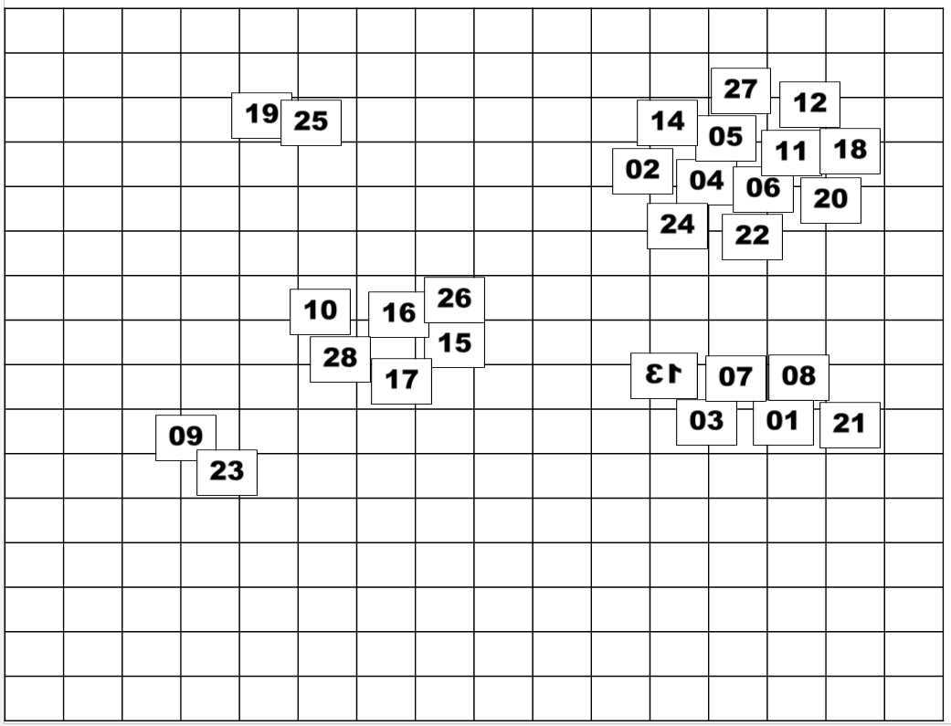
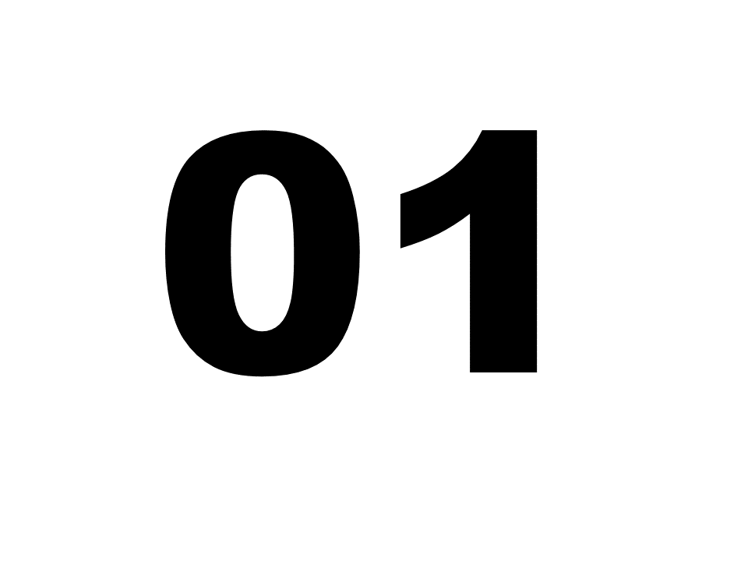
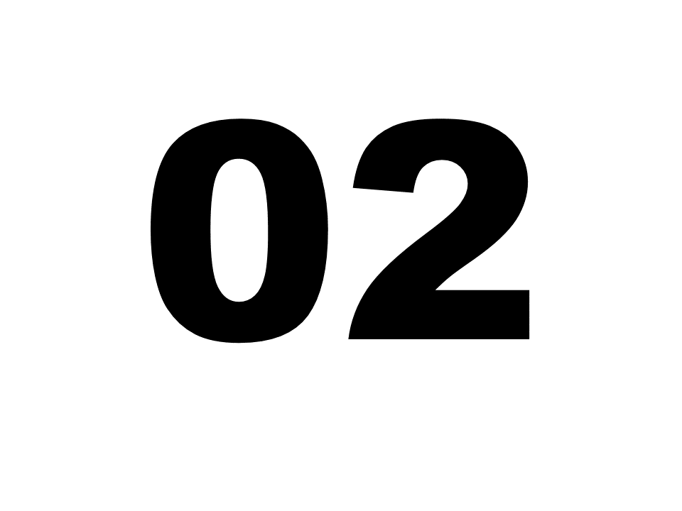
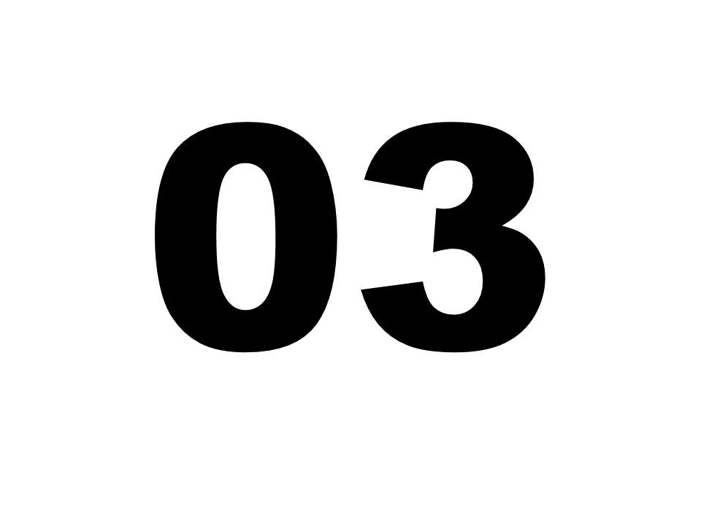
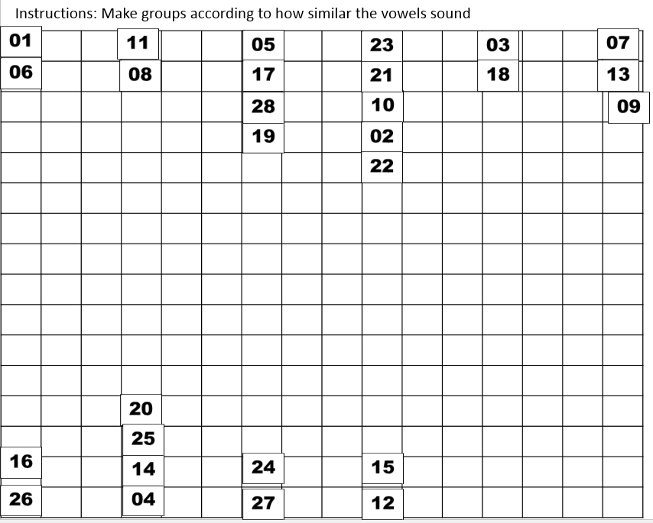
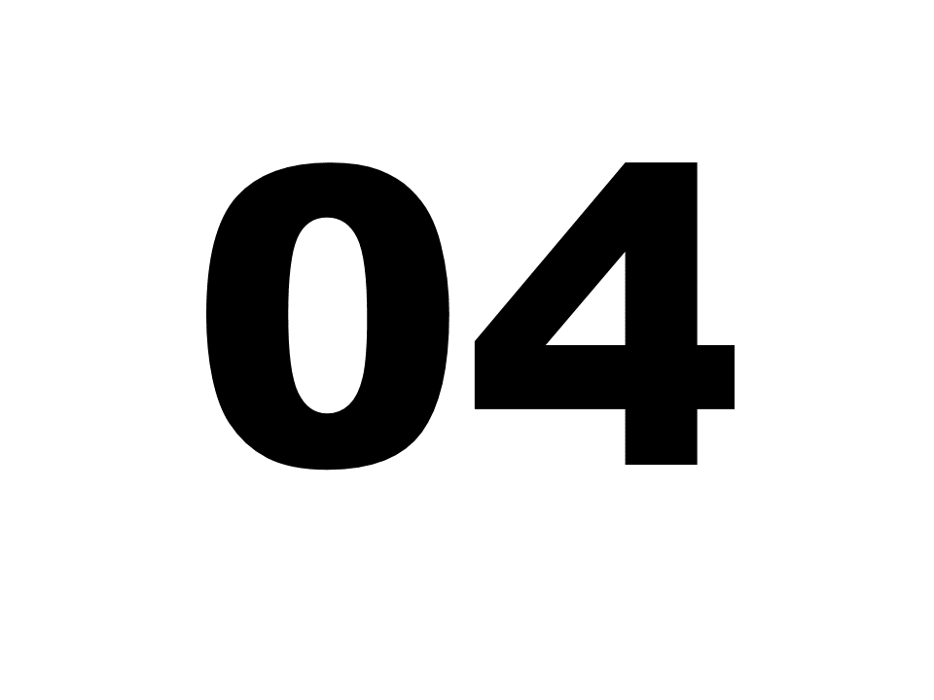
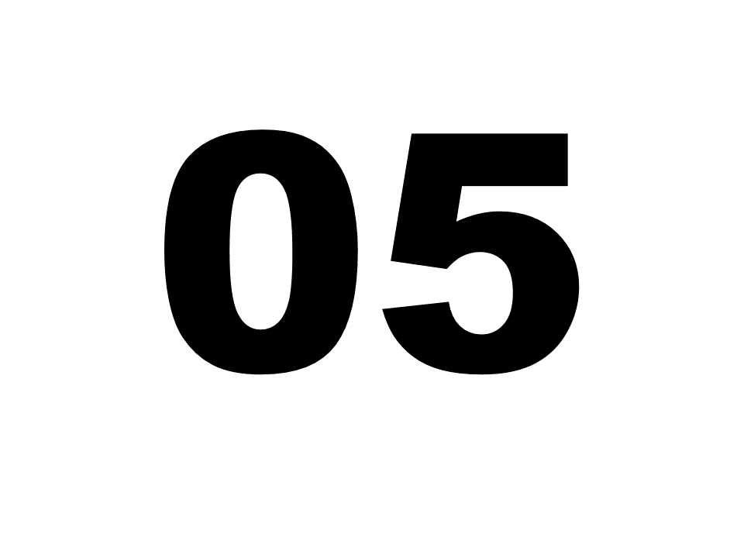
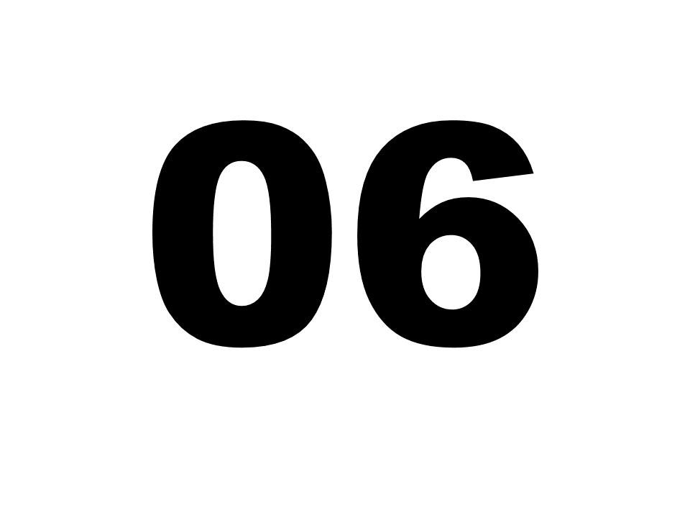
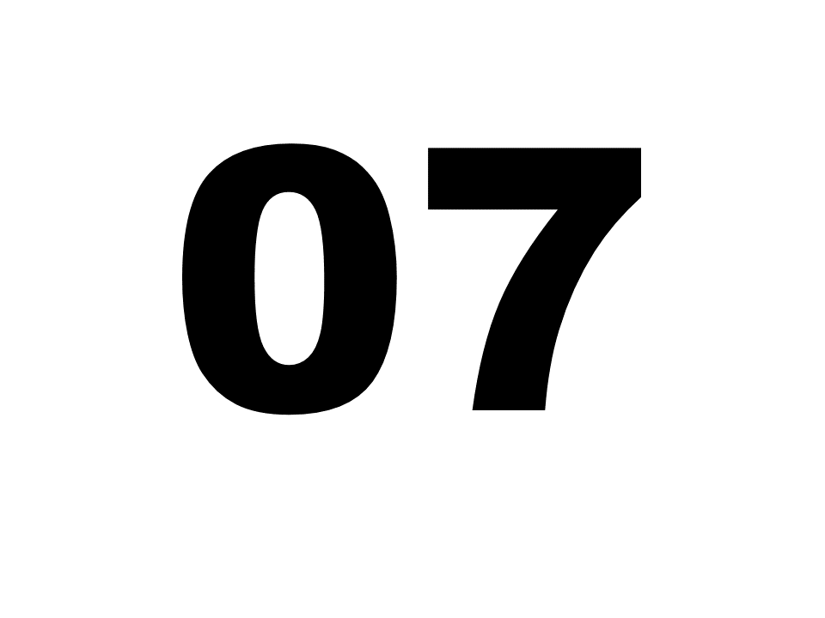
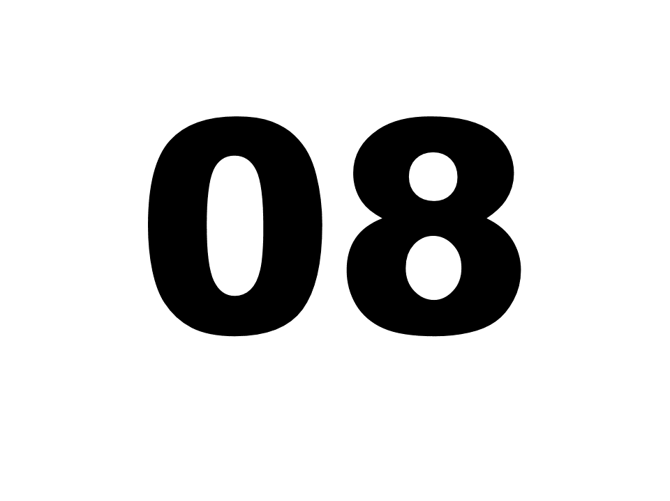
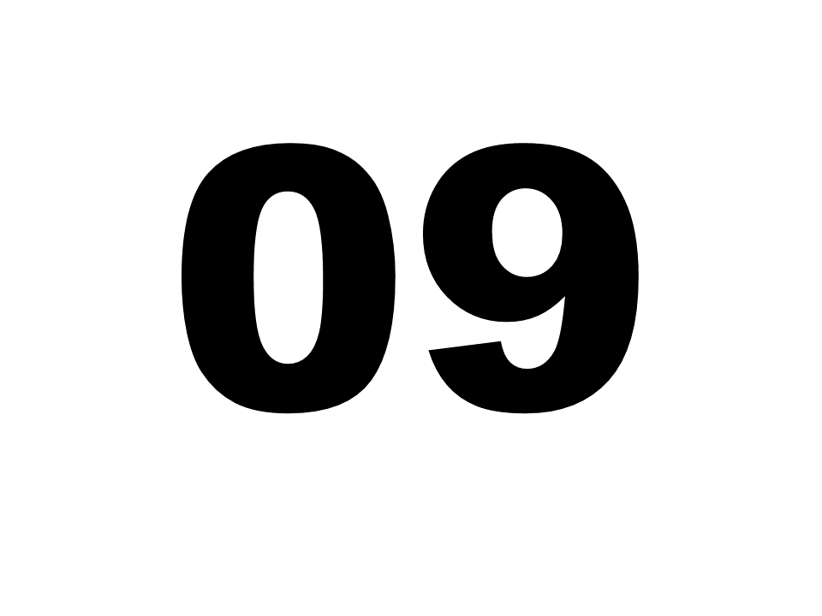
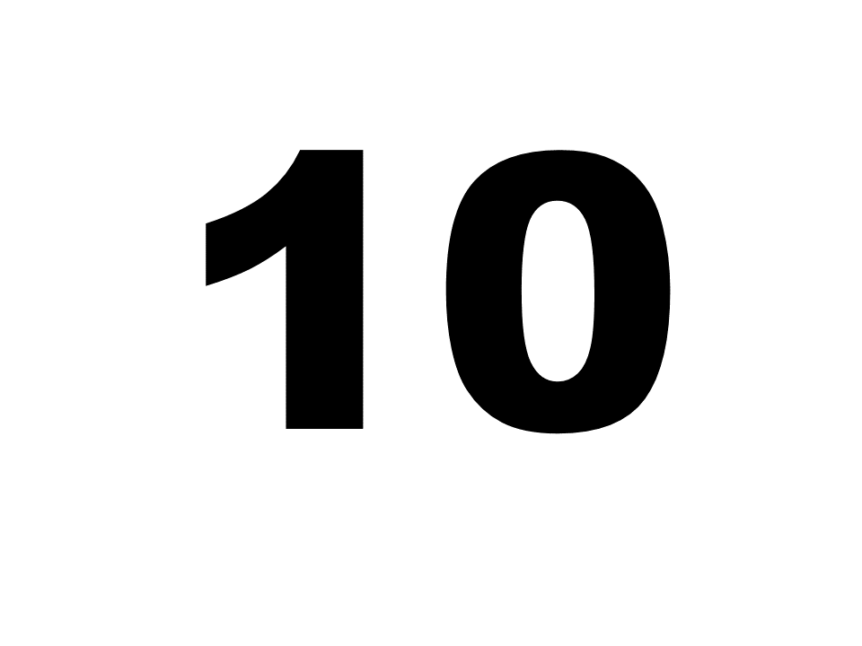
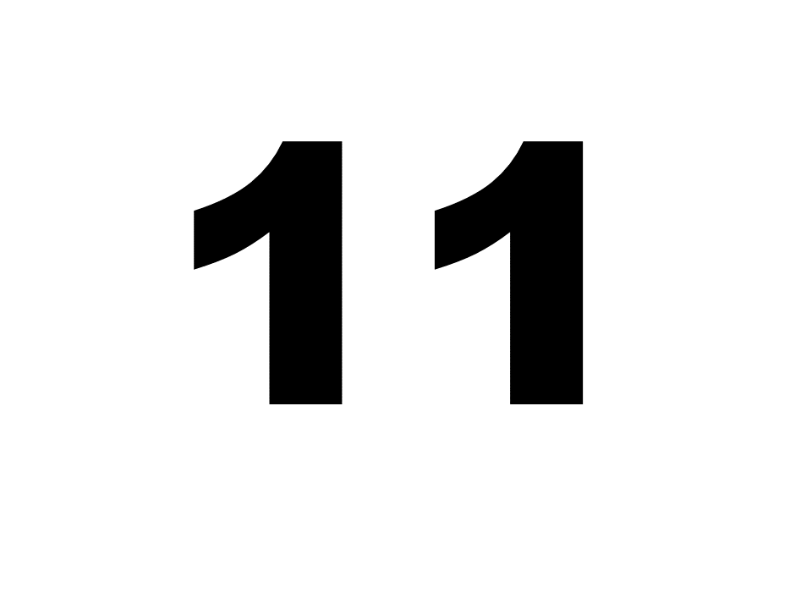
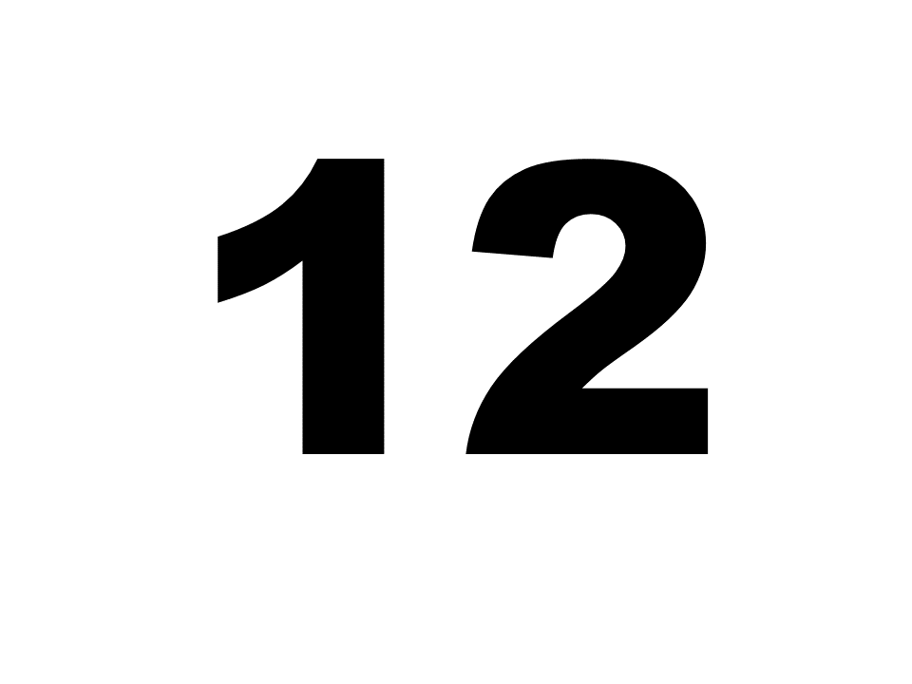
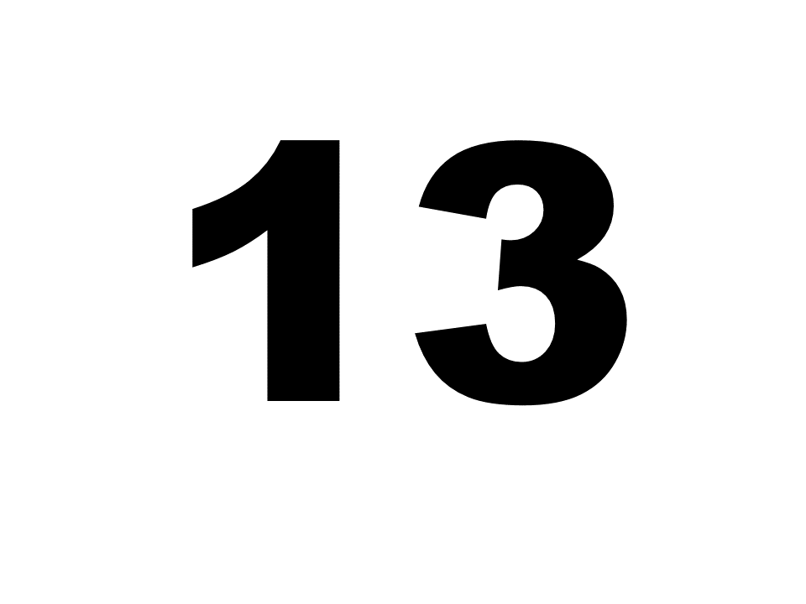
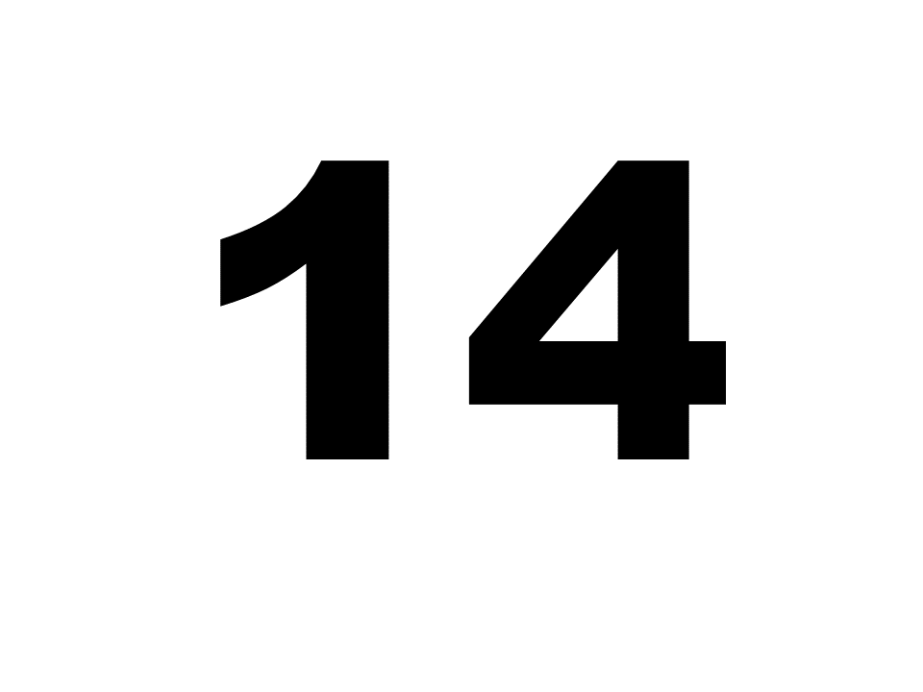
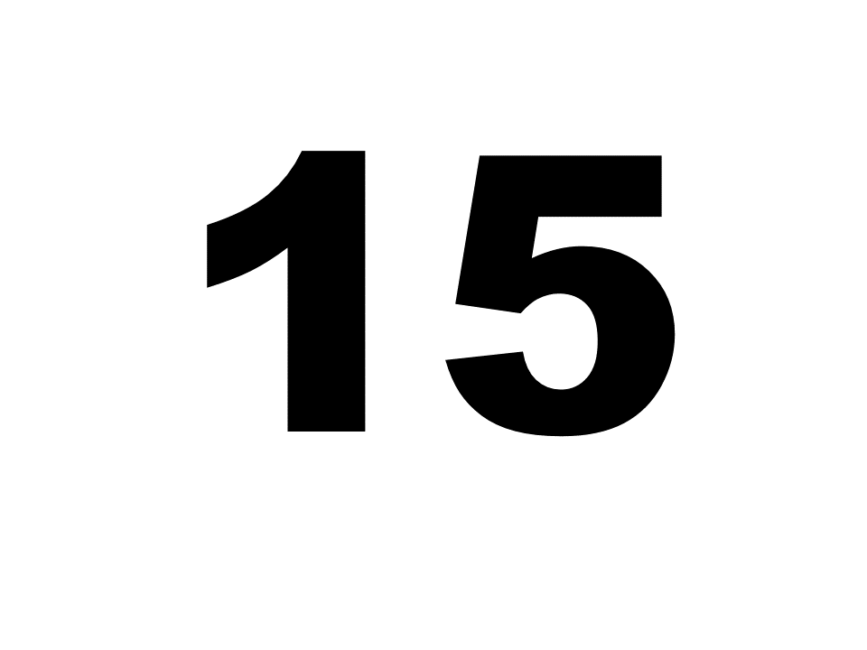
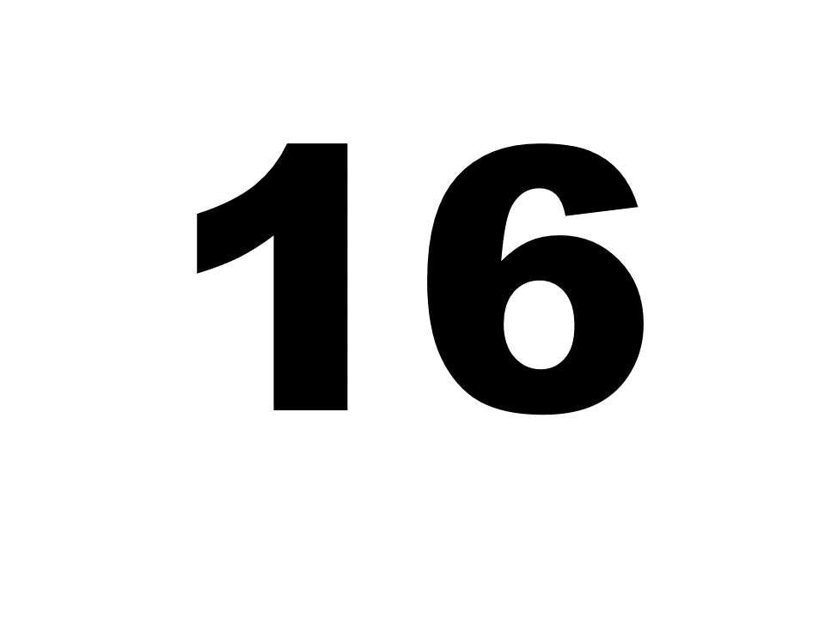
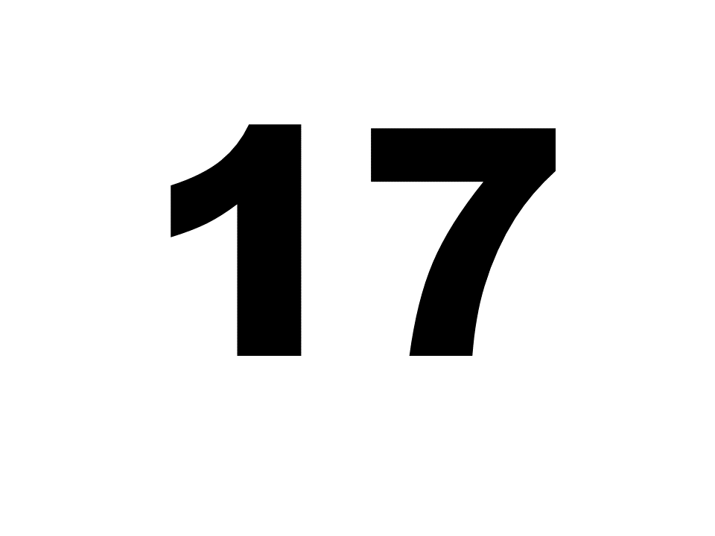
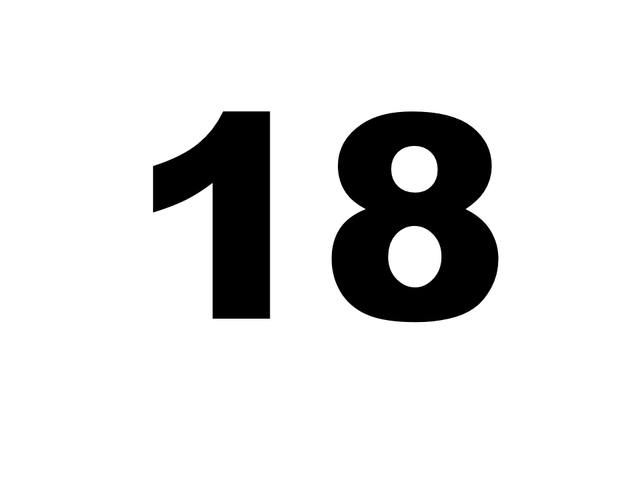
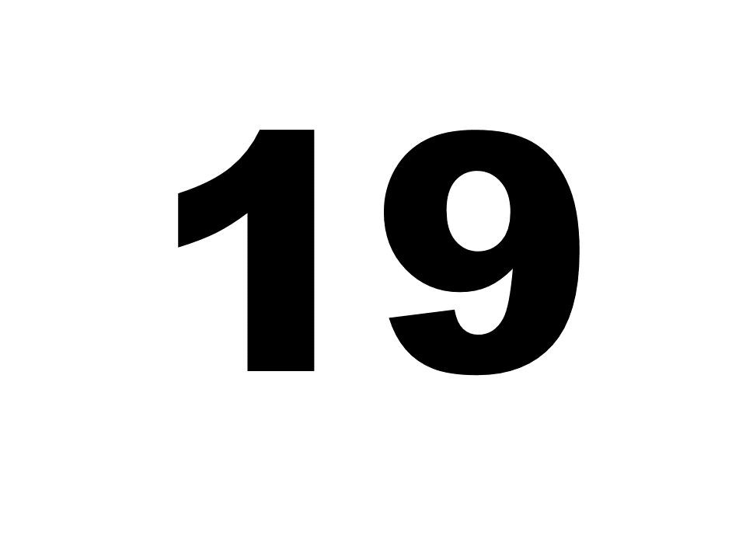
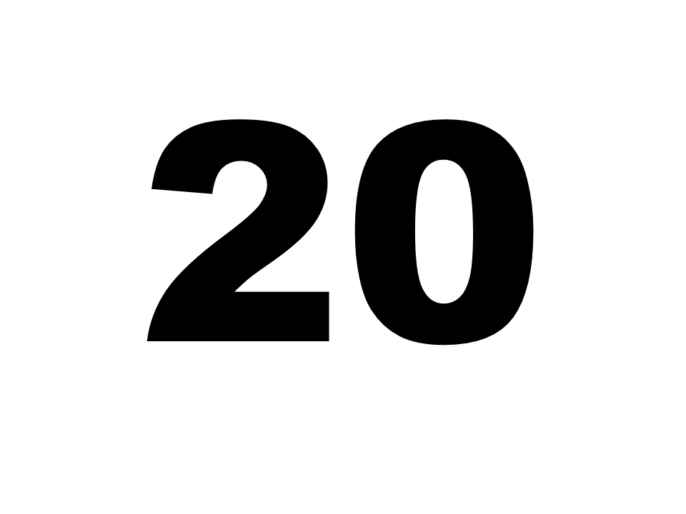
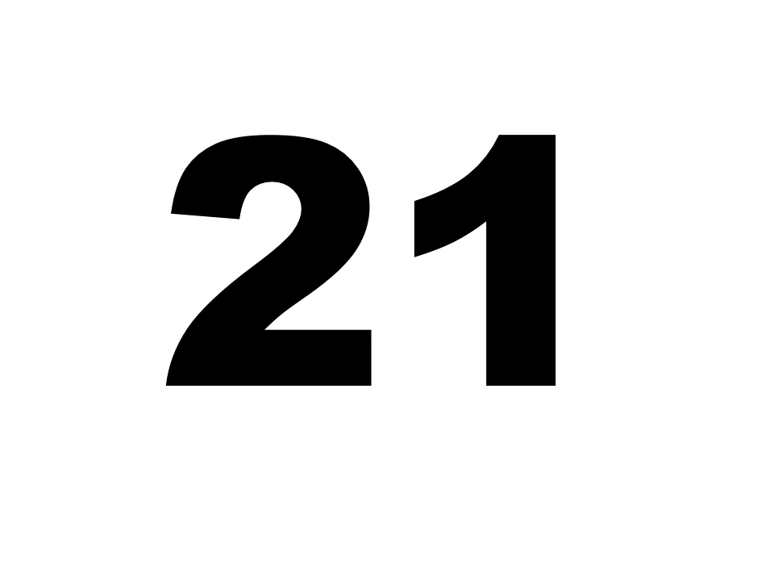
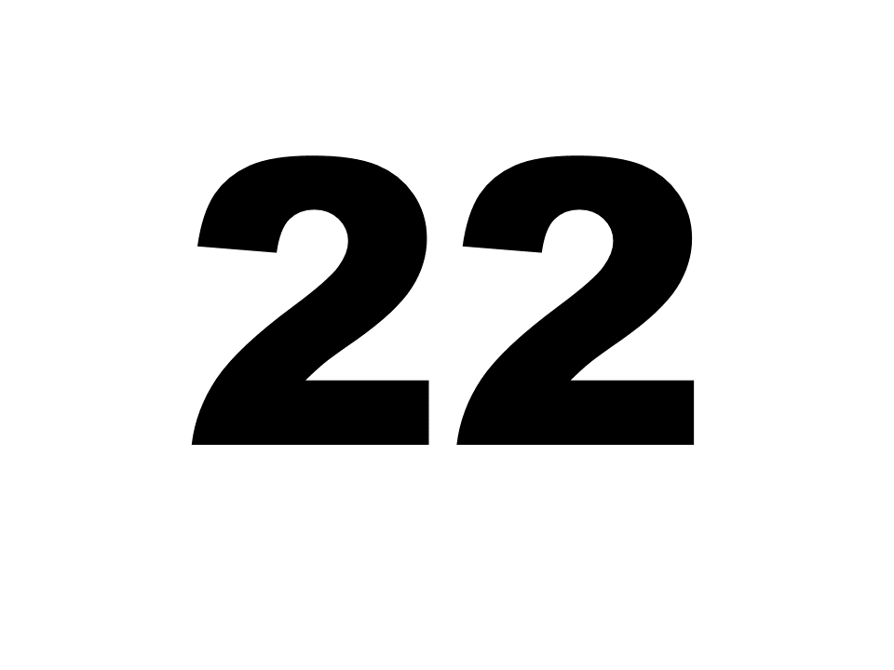
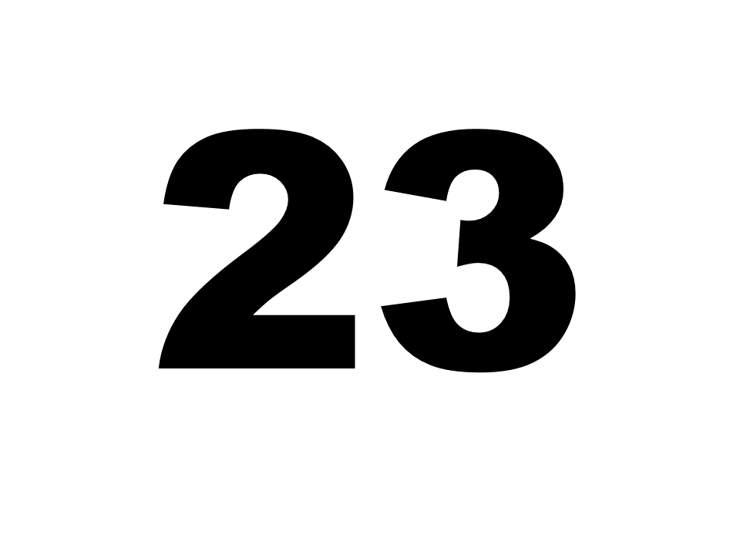
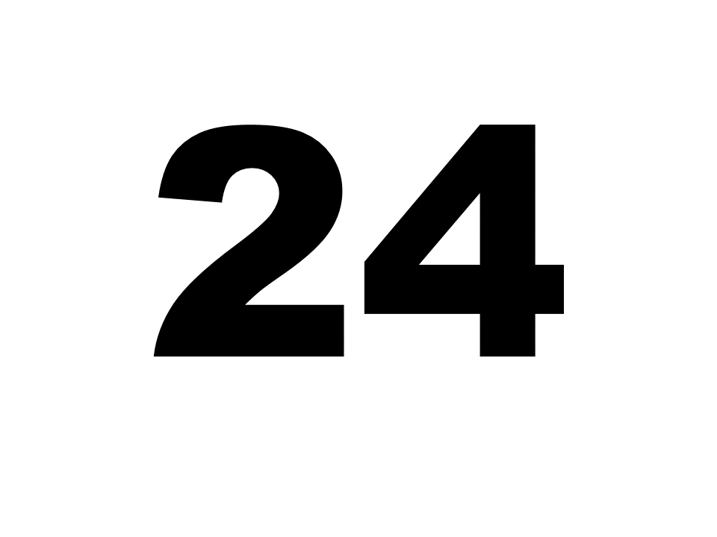
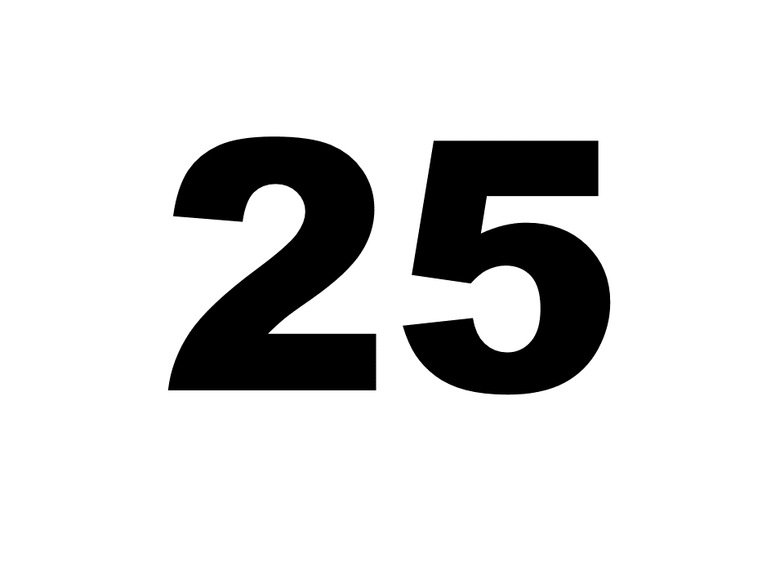
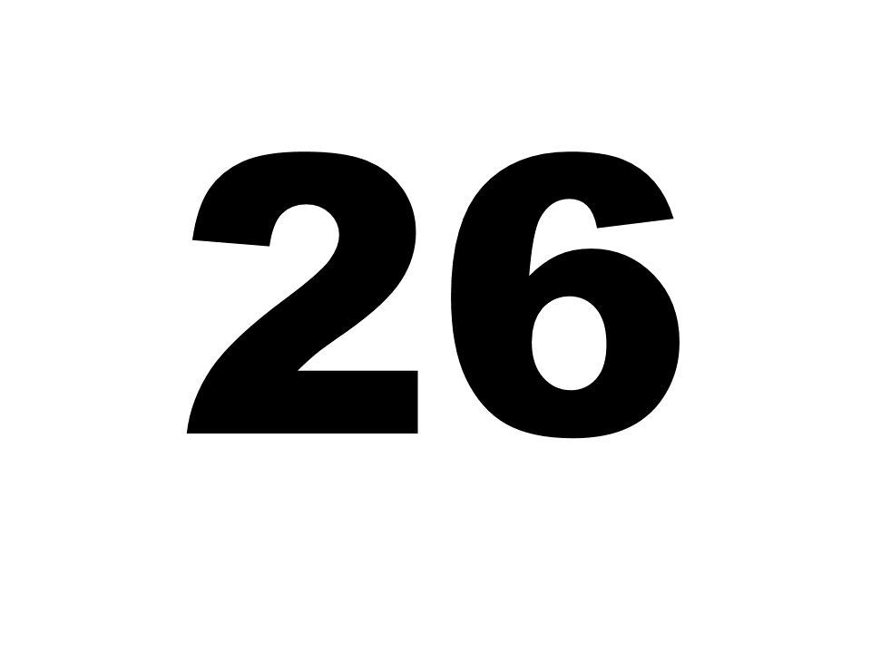
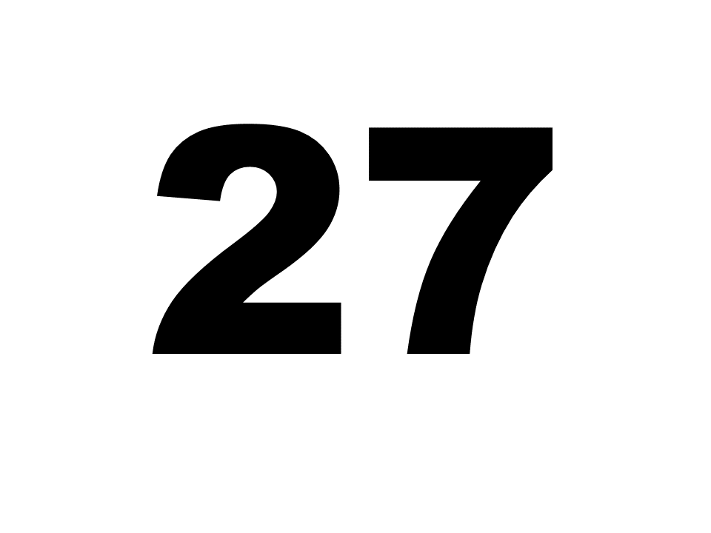
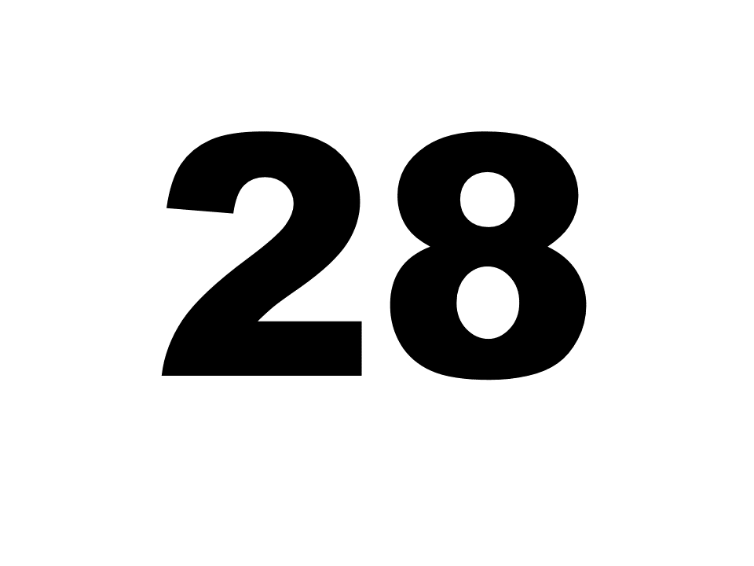
Free Classification (FC)
Instructions: Make groups of 2 or more similar-sounding vowels. Ignore the sex of the speaker.
Each participant completed three slides:
  28 velar context token (2 speakers x 14 vowels)
  28 alveolar context token (2 speakers x 14 vowels)
  3rd slide identical to 1st
  Conducted in PowerPoint

Slide 13
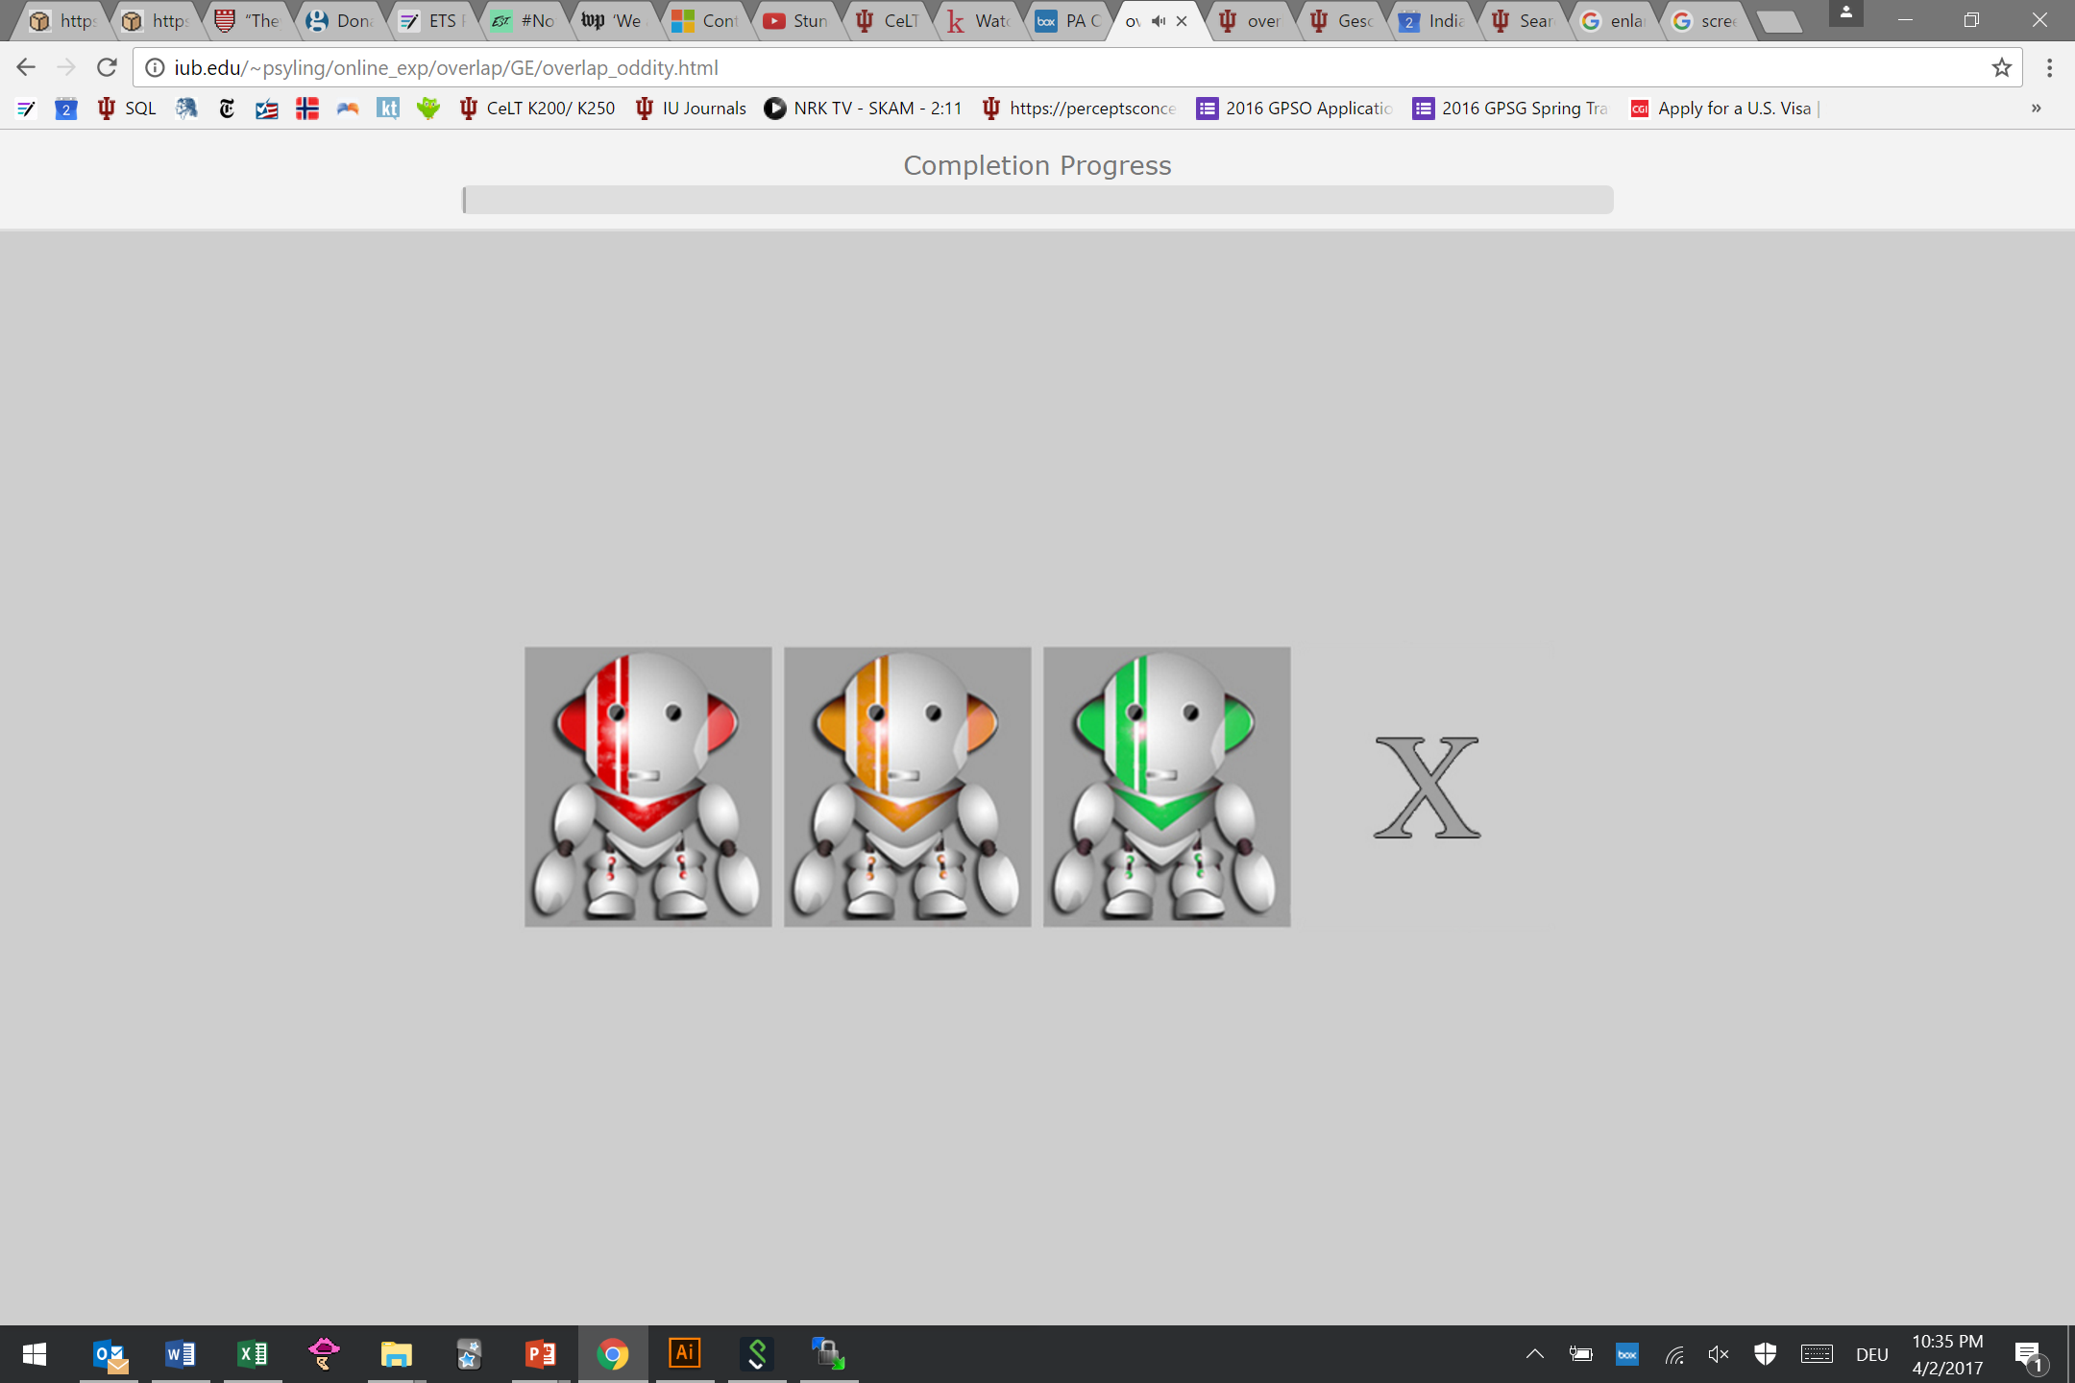
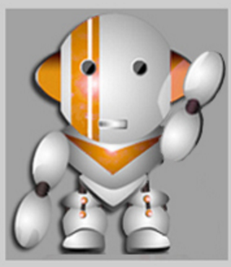
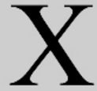
Oddity
Instructions: Click on the robot that said something different. If all say the same word, click X. Response time is 2 seconds.
220 triads
  110 skVk
  110 ʃtVt
  ISI 400ms
  Timeout 2500ms
speakers: 2 female, 1 male
Conducted online through jsPsych
1 | u ~ y
2 | u ~ o
3 | y ~ ø
4 | o ~ e
5 | i ~ e
6 | i ~ a
7 | ɪ ~ ɛ
8 | ɪ ~ ʏ
9 | e ~ ɛ
10 | e ~ a
11 | ø ~ ʏ

Slide 14
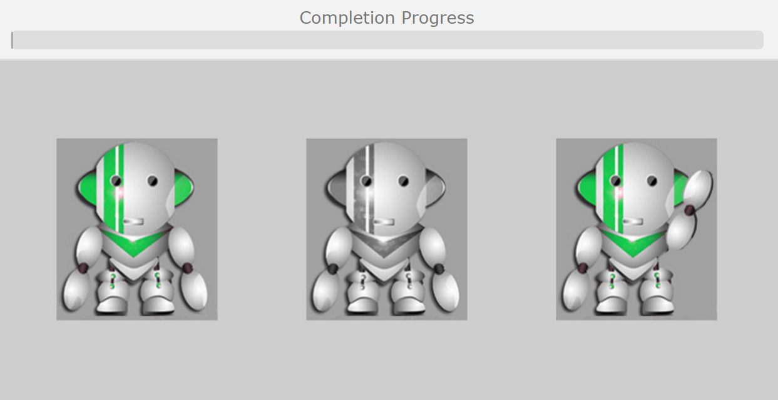
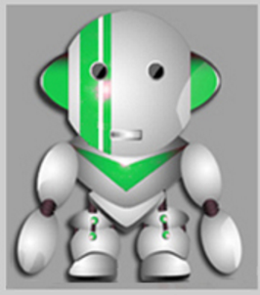
AXB
Instructions: Click on the green robot that said the same word as the grey robot. Response time is 2 seconds.
220 triads
  110 skVk
  110 ʃtVt
  ISI 1000ms
  Timeout 2500ms
speakers: 1 female, 1 male
Conducted online through jsPsych
1 | u ~ y
2 | u ~ o
3 | y ~ ø
4 | o ~ e
5 | i ~ e
6 | i ~ a
7 | ɪ ~ ɛ
8 | ɪ ~ ʏ
9 | e ~ ɛ
10 | e ~ a
11 | ø ~ ʏ

Slide 15

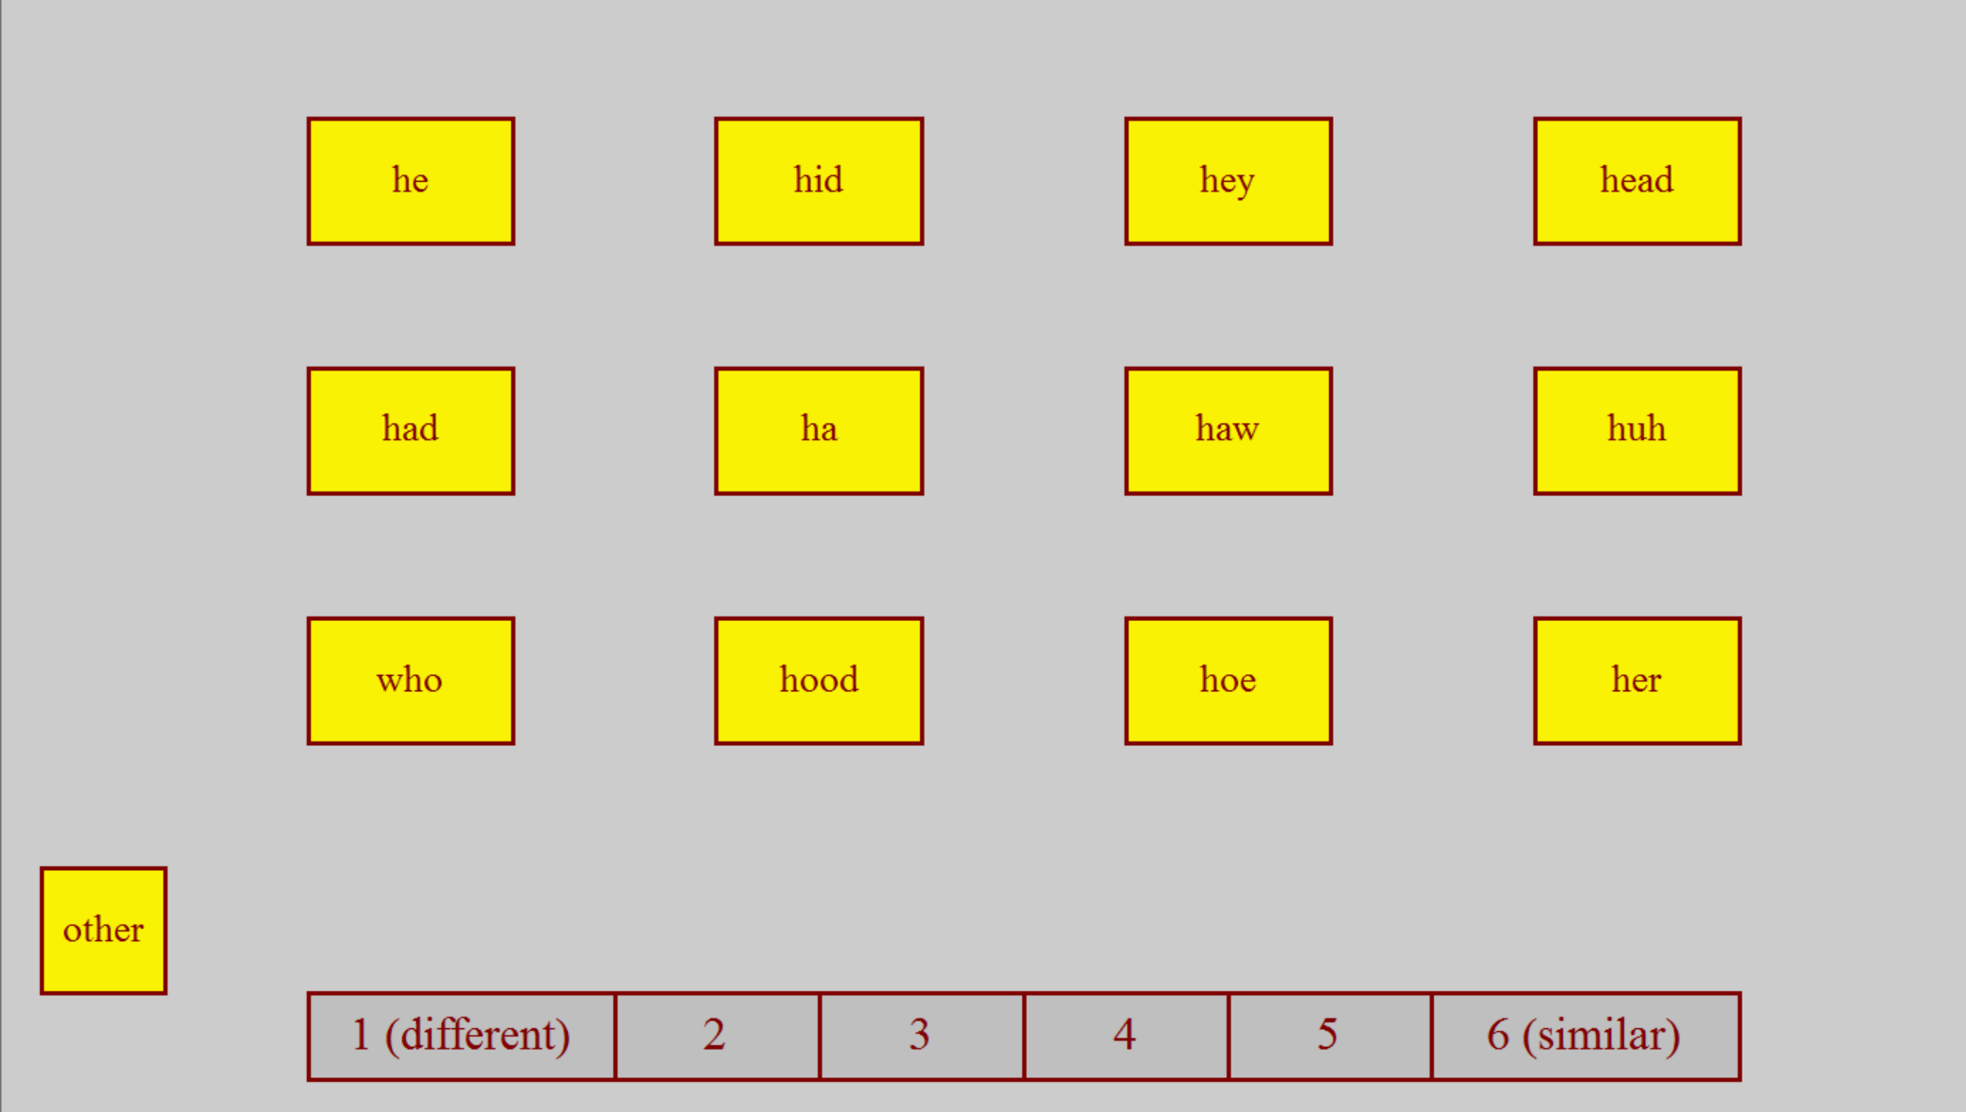
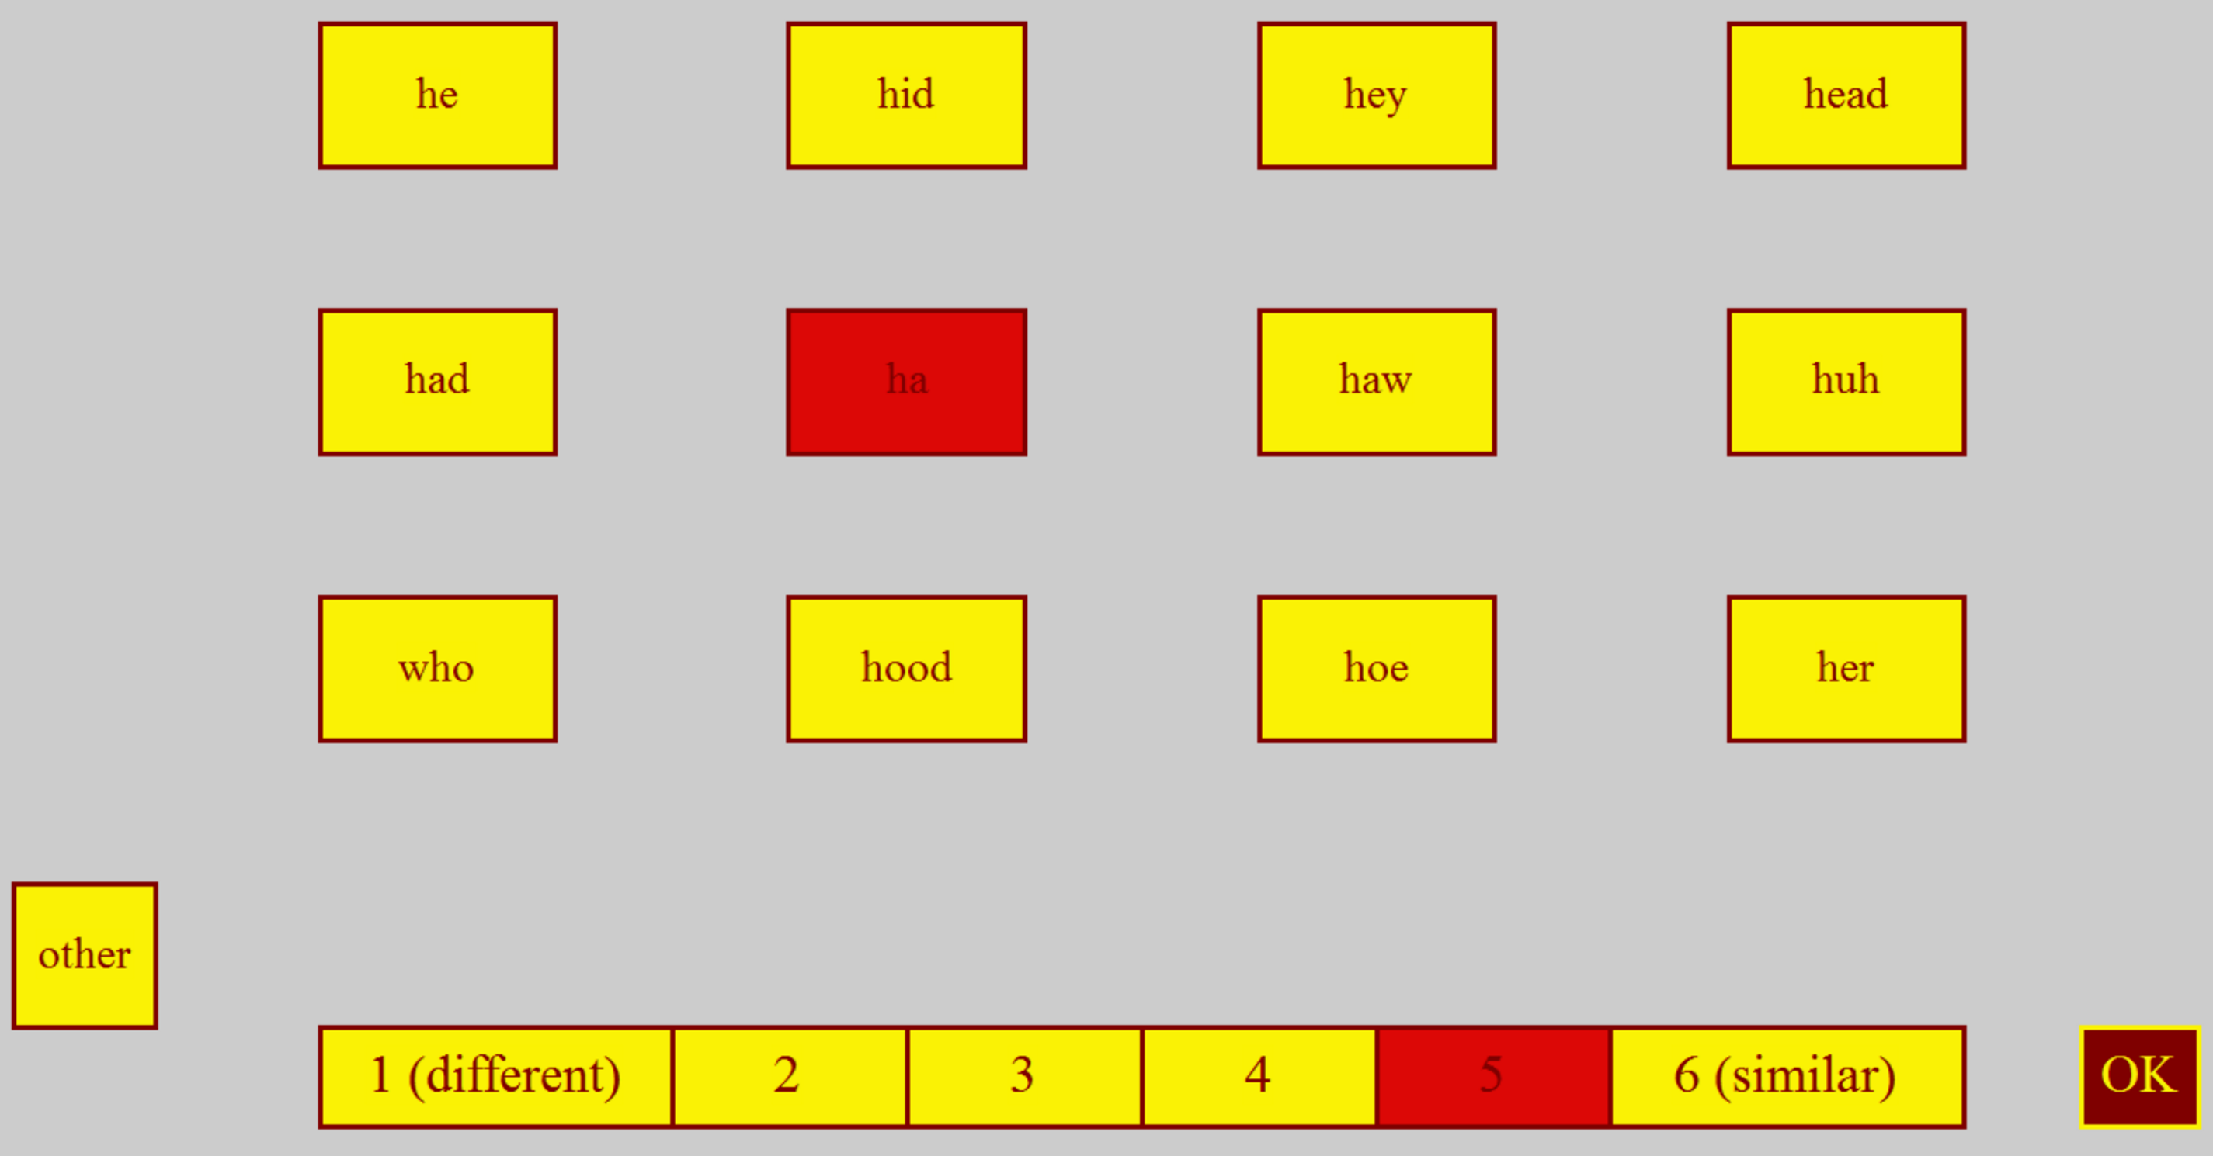
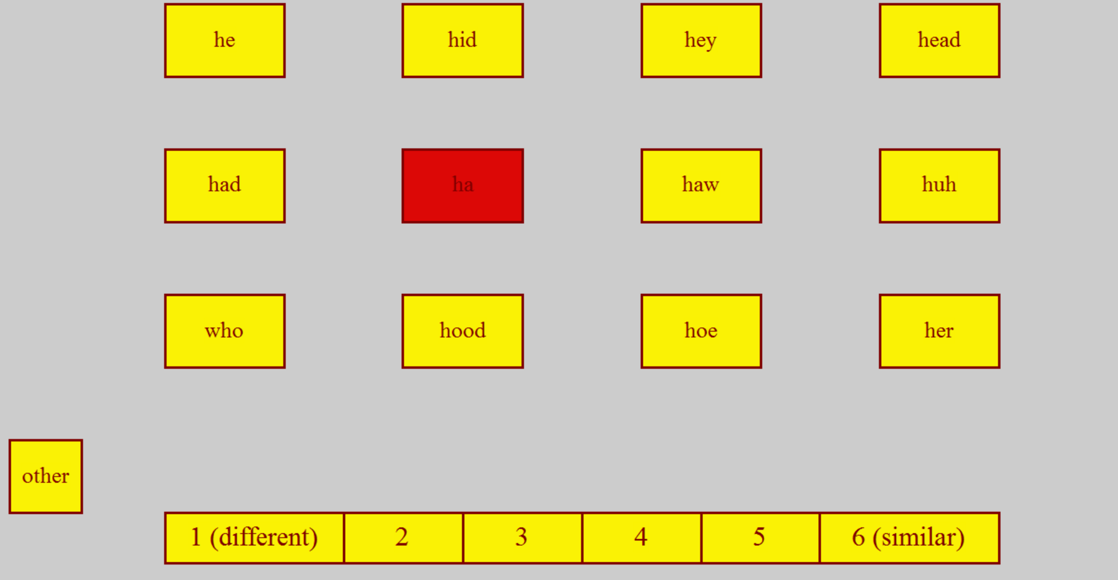
Perceptual Assimilation
Instructions: Click the vowel that is most similar to the one you heard. Then decide how similar or different the vowel was.
Familiarization → Training → Check
160 trials
4 speakers (2 female, 2 male)
Contexts: skVk, ʃtVt
10 vowels:
  [a], [e:], [ɛ], [i:], [ɪ], [o:], [ø:], [u:], [y:], [ʏ]
Conducted in Praat

Slide 16
Results: Perceptual Assimilation
Combined Total |  | AE Vowel
 |  | he i | hid ɪ | hey eɪ | head ɛ | had æ | huh ʌ | her ɝ | ha ɑ | haw ɔ | hoe oʊ | hood ʊ | who u | other
German Vowel | i | 92.5 | 3.6 | 1.4 | 1.8 | 0.1 | 0.0 | 0.1 | 0.0 | 0.0 | 0.0 | 0.0 | 0.0 | 0.4
 | ɪ | 4.2 | 69.9 | 11.3 | 12.9 | 0.1 | 0.0 | 0.2 | 0.1 | 0.0 | 0.0 | 0.3 | 0.1 | 0.9
 | e | 22.2 | 18.3 | 46.9 | 9.6 | 0.2 | 0.0 | 0.4 | 0.2 | 0.0 | 0.0 | 0.2 | 0.4 | 1.4
 | ɛ | 2.8 | 2.3 | 10.8 | 81.7 | 0.2 | 0.2 | 0.9 | 0.0 | 0.1 | 0.1 | 0.0 | 0.0 | 1.0
 | a | 0.1 | 0.0 | 0.0 | 1.3 | 5.6 | 45.9 | 0.0 | 35.2 | 10.3 | 0.4 | 0.2 | 0.2 | 0.6
 | o | 0.0 | 0.0 | 0.0 | 0.0 | 0.1 | 1.4 | 0.2 | 2.6 | 35.8 | 37.9 | 12.5 | 5.8 | 3.7
 | ø | 0.0 | 0.3 | 0.6 | 0.2 | 0.1 | 12.1 | 6.3 | 0.0 | 0.3 | 1.4 | 61.5 | 15.8 | 1.3
 | u | 0.1 | 0.0 | 0.0 | 0.0 | 0.0 | 0.4 | 0.0 | 0.2 | 1.5 | 1.1 | 17.8 | 77.6 | 1.2
 | y | 0.3 | 0.5 | 0.4 | 0.0 | 0.0 | 2.0 | 0.2 | 0.0 | 0.2 | 0.1 | 21.9 | 72.0 | 2.3
 | ʏ | 0.1 | 2.5 | 0.0 | 0.6 | 0.1 | 20.0 | 2.5 | 0.2 | 0.3 | 0.2 | 67.4 | 4.6 | 1.5

Slide 17
Difficulties with PA Category Types
C (Categorized) vs UC (Uncategorized)
UC can be further subdivided (Faris et al., 2016) into:
  UCF (Focalized): only one category was chosen more than chance
  UCC (Clustered): two categories chosen more than chance
  UCD (Dispersed): >2 chosen more than chance (or none at above chance level?)
Contrast | 50% Cutoff | 70% Cutoff | 90% Cutoff
i ~ a
i ~ e
u ~ o
e ~ ɛ
ɪ ~ ʏ
C-UC
C-UC
C-UC
C-UC
UC-UC
C-UC
C-UC
C-UC
C-UC
2C
C-UCC
C-UCC
C-UCC
C-UCC
UCF-UCF
C-UCC
C-UCC
UCF-UCC
UCF-UCC
UCF-UCF
C-UCC
C-UCC
C-UCC
C-UCC
2C

Slide 18
Calculating Overlap Scores (Levy, 2009)
Combined Total |  | AE Vowel
 |  | he i | hid ɪ | hey eɪ | head ɛ | had æ | huh ʌ | her ɝ | ha ɑ | haw ɔ | hoe oʊ | hood ʊ | who u
German Vowel | ɪ | 3.5 | 61.7 | 14.8 | 17.6 | 0.4 | 0.0 | 0.0 | 0.0 | 0.0 | 0.0 | 0.0 | 0.0
 | e | 26.2 | 16.4 | 44.5 | 10.9 | 0.0 | 0.0 | 0.0 | 0.0 | 0.0 | 0.0 | 0.4 | 0.4
How similarly were German vowels categorized overall
  Example: /ɪ/~/e/
Goodness weighting: German /ɪ/~/e/
→ 3.5 + 16.4 + 14.8
+ … = 44.8%
$$Overlap ∗\left(1−Difference in Goodness\right)=Weighted Overlap$$
/ɪ/ rated as 3.17 out of 6 (52.8%) as AE /i/
/e/ rated as 3.73 out of 6 (62.2%) as AE /i/
Difference of 9.4%
$$3.5\%∗ \left(1−0.094\right) = 3.28\%$$

Slide 19
Overlap Scores
Note: even taking goodness into account, overlap scores are not based on PAM in that they compare non-native to non-native, not to L1 sounds
  Essentially, this analysis converts PA results to a similarity judgment

Slide 20
Results: Free Classification
Multidimensional Scaling (MDS) visualizes distances between stimuli
Best model recreation of observed distances
  Ex: X and Y grouped together 90% of the time
X
.1
Y
y
.4
u
.99
i
ø
.4
y
.99
i
u
.4
ø
.99
i
i
y
u
ø

Slide 21
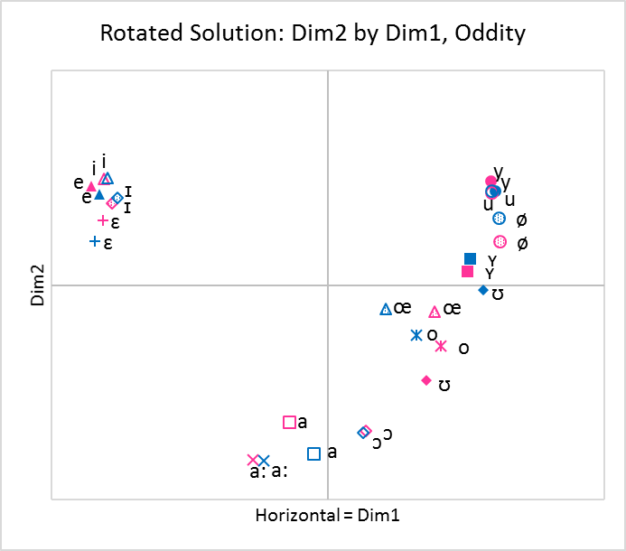
Multidimensional Scaling (MDS) Output

Slide 22
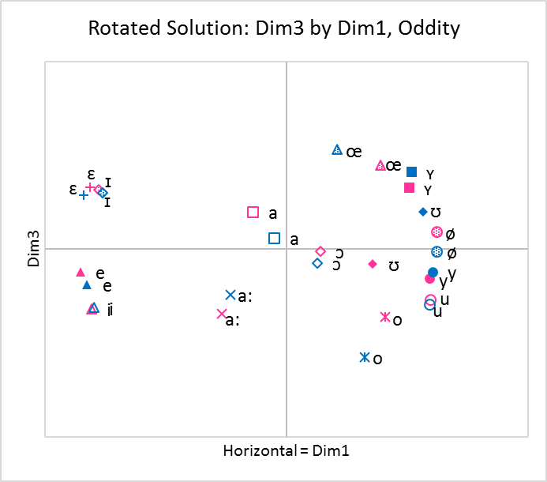
3-Dimensional Solutions
Correlations between 3-D Coordinates and Acoustic and Phonological Measures (Oddity Group)
 | f0 | F1 | F2 | F3 | Duration | dB | Gender | Roundedness | Phonological Length
Dim1 | 0.025 | -0.146 | -0.681 | -0.650 | -0.038 | 0.159 | 0.007 | 0.973 | 0.072
Dim2 | 0.112 | -0.815 | 0.517 | 0.498 | -0.133 | 0.222 | 0.026 | -0.287 | 0.314
Dim3 | 0.008 | 0.261 | 0.260 | -0.248 | -0.646 | 0.128 | -0.011 | -0.033 | -0.801

Slide 23
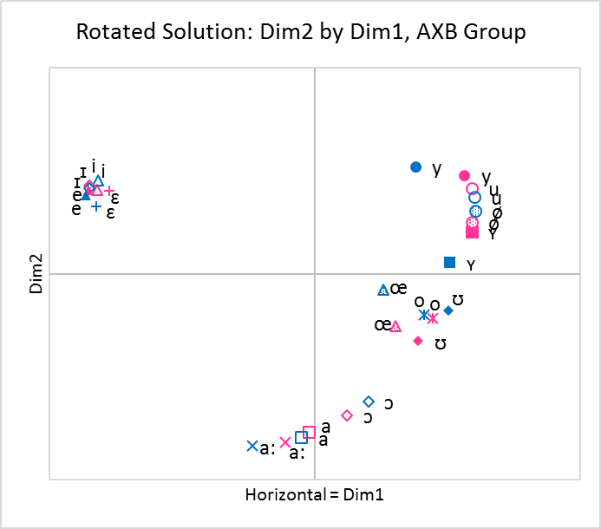
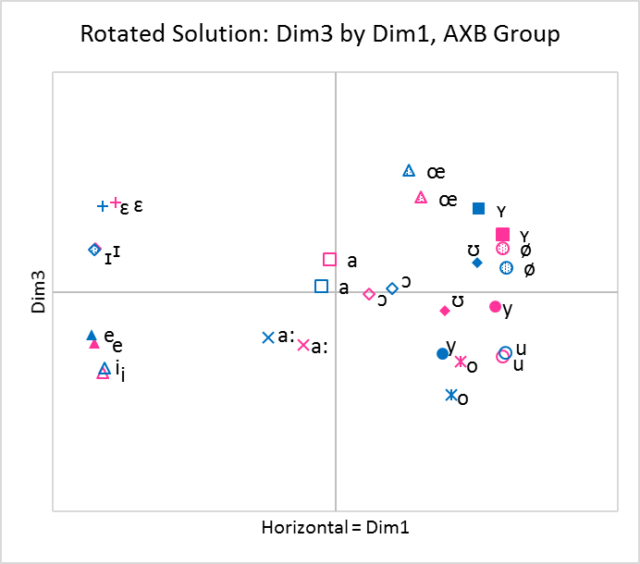
3-Dimensional Solutions
Correlations between 3-D Coordinates and Acoustic and Phonological Measures (AXB Group)
 | f0 | F1 | F2 | F3 | Duration | dB | Gender | Roundedness | Phonological Length
Dim1 | -0.010 | -0.085 | -0.716 | -0.652 | -0.014 | 0.157 | -0.021 | 0.976 | 0.061
Dim2 | 0.097 | -0.808 | 0.501 | 0.472 | -0.141 | 0.220 | 0.015 | -0.277 | 0.291
Dim3 | 0.004 | 0.344 | 0.165 | -0.325 | -0.536 | 0.076 | 0.000 | 0.034 | -0.765

Slide 24
Results: Discrimination
In general, Oddity was a harder task, exhibiting more variation in scores
Still, AXB and Oddity results were quite comparable
  High correlations
    Accuracy rates (r = .974)
    d’ (r = .979)
Contrasts with front-rounded vowels were the most difficult

Slide 25
Comparisons for Oddity Group
 | Discrimination |  | Perceptual Assimilation |  |  |  |  | Free Classification
Contrast | Oddity d' | Oddity Accuracy | PA Types at 50% Cutoff | PA Types at 70% Cutoff | PA Types at 90% Cutoff | Levy Overlap | Goodness-Weighted Overlap | MDS Weighted Distances | Raw Overlap
ø ~ ʏ | 0.948 | 0.54 | 1 | 4 | 1 | 0.793 | 0.771 | 0.85 | 0.379
y ~ ø | 1.302 | 0.634 | 9 | 9 | 4 | 0.384 | 0.366 | 0.757 | 0.409
u ~ y | 1.344 | 0.626 | 1 | 1 | 2 | 0.969 | 0.939 | 0.485 | 0.567
ɪ ~ ɛ | 1.919 | 0.756 | 9 | 9 | 8 | 0.258 | 0.242 | 0.745 | 0.398
i ~ e | 1.932 | 0.765 | 5 | 5 | 8 | 0.274 | 0.231 | 0.687 | 0.468
ɪ ~ ʏ | 2.293 | 0.848 | 9 | 9 | 8 | 0.066 | 0.057 | 2.802 | 0.035
u ~ o | 2.31 | 0.839 | 5 | 5 | 4 | 0.207 | 0.183 | 1.569 | 0.21
e ~ ɛ | 2.409 | 0.861 | 5 | 5 | 4 | 0.251 | 0.229 | 1.309 | 0.277
e ~ a | 2.719 | 0.923 | 3 | 2 | 3 | 0.031 | 0.025 | 3.125 | 0.011
o ~ e | 2.783 | 0.927 | 3 | 2 | 4 | 0.017 | 0.014 | 3.199 | 0.005
i ~ a | 2.904 | 0.948 | 5 | 5 | 8 | 0.014 | 0.014 | 3.199 | 0.005
Correlation with d’ | -- | 0.998 | 0.456 | 0.188 | 0.687 | -0.871 | -0.867 | 0.831 | -0.829
Most difficult
Easiest

Slide 26
Comparisons for AXB Group
 | Discrimination |  | Perceptual Assimilation |  |  |  |  | Free Classification
Contrast | AXB d’ | AXB Accuracy | PA Types at 50% Cutoff | PA Types at 70% Cutoff | PA Types at 90% Cutoff | Levy Overlap | Goodness-Weighted Overlap | MDS Weighted Distances | Raw Overlap
ø ~ ʏ | 1.22 | 0.725 | 1 | 1 | 2 | 0.865 | 0.854 | 0.689 | 0.436
y ~ ø | 1.72 | 0.812 | 9 | 6 | 7 | 0.451 | 0.438 | 1.033 | 0.333
u ~ y | 2.015 | 0.852 | 2 | 3 | 1 | 0.885 | 0.809 | 0.66 | 0.489
i ~ e | 2.333 | 0.887 | 5 | 7 | 10 | 0.321 | 0.276 | 0.536 | 0.478
ɪ ~ ɛ | 2.346 | 0.887 | 9 | 11 | 7 | 0.299 | 0.281 | 0.725 | 0.444
ɪ ~ ʏ | 2.889 | 0.953 | 9 | 5 | 7 | 0.013 | 0.012 | 3.206 | 0.006
u ~ o | 2.899 | 0.948 | 5 | 7 | 4 | 0.242 | 0.226 | 1.184 | 0.272
e ~ ɛ | 2.93 | 0.952 | 5 | 7 | 4 | 0.269 | 0.23 | 1.45 | 0.186
e ~ a | 3.16 | 0.98 | 3 | 2 | 3 | 0.015 | 0.012 | 3.137 | 0.006
o ~ e | 3.2 | 0.983 | 3 | 4 | 4 | 0.004 | 0.003 | 3.241 | 0.003
i ~ a | 3.223 | 0.987 | 5 | 7 | 10 | 0.01 | 0.01 | 3.241 | 0.003
Correlation with d’ | -- | (.996) | 0.439 | 0.339 | 0.550 | -0.882 | -0.897 | 0.760 | -0.798
Most difficult
Easiest

Slide 27
Discussion
Using perceptual assimilation category types was challenging for several reasons
  Arbitrary cutoffs changed the nature and rank order of discriminability predictions
  Several contrasts that differed in discriminability were categorized the same way, and vice versa
Using overlap scores instead provided easily reproducible results
  Weighting overlap scores by goodness rating differences did not consistently increase predictive power

Slide 28
Discussion
In our study, PA overlap scores predicted discriminability better than FC
  Caveats:
    PA results are based on 32 trials per subject per contrast vs 12 for FC
    30 minutes for PA vs ~15 for FC
    With PA, need to impose labels and ensure subjects understand them
    For some phonemes (e.g. ʕ, ʔ) or contrasts (e.g. phonemic length, tone), or for non-alphabetic writing systems, PA might not be doable
Separately, if we use overlap scores (goodness-weighted or unweighted), we are essentially using a PA task to obtain similarity judgments

Slide 29
Discussion
FC predicted discriminability slightly less well than PA overlap scores, but it had several advantages
  MDS output provided data on which dimensions stimuli differed perceptually
  No category labels or metalanguage
However, FC tended to overpredict difficulty for vowels that are similar, yet discriminable (e.g. /i/~/e/)
  Other perceptual similarity tasks such as a simple perceptual similarity judgment task could address this concern, but would be limited to fewer target phonemes

Slide 30
Conclusion
By using these new tasks and/or the revised analytic methods, researchers can provide:
  More systematic predictions for which sounds beginning L2 learners will struggle with
  Using MDS can even help deduce which cues are or are not being relied on

Slide 31
Thank you!
Questions? Comments?
Contact info:
  Danielle Daidone ddaidone@indiana.edu
  Ryan Lidster rflidste@umail.iu.edu
  Franziska Kruger fkruger@indiana.edu
  Meg Cychosz mychosz@berkeley.edu

Slide 32
References
Best, C.T (1995). A direct realist perspective on cross-language speech perception. In W. Strange & J. Jenkins (eds.), Speech perception and linguistic experience: Issues in cross-language research (pp. 171-204). Timonium, MD: York Press.
Best, C., & Tyler, M. (2007). Nonnative and second-language speech perception: Commonalities and complementarities. In O.-S. Bohn & M. Munro (Eds.), Language experience in second language speech learning: In honor of James Emil Flege (pp. 13-34). Philadelphia, PA: John Benjamins.
Daidone, D., Kruger, F., & Lidster, R. (2015). Perceptual assimilation and free classification of German vowels by American English listeners. In The Scottish Consortium for ICPhS 2015 (Eds.), Proceedings of the 18th International Congress of Phonetic Sciences. Glasgow, UK: Glasgow University.
Escudero, P. (2005). Linguistic perception and second-language acquisition: Explaining the attainment of optimal phonological categorization (Unpublished doctoral dissertation). Utrecht University, The Netherlands.
Faris, M. M., Best, C. T., & Tyler, M. D. (2016). An examination of the different ways that non-native phones may be perceptually assimilated as uncategorized. The Journal of the Acoustical Society of America, 139(1), EL1-EL5.
Flege, J. E. (1995). Second language speech learning: Theory, findings, and problems. In W. Strange (Ed.), Speech perception and linguistic experience: Issues in cross-language research (pp. 233-277). Timonium, MD: York Press.
Flege, J. E., Munro, M. J., & Fox, R. A. (1994). Auditory and categorical effects on cross‐language vowel perception. The Journal of the Acoustical Society of America, 95(6), 3623-3641.
Harnsberger, J. D. (2001). On the relationship between identification and discrimination of non-native nasal consonants. The Journal of the Acoustical Society of America, 110(1), 489-503.
Iverson, P., Kuhl, P. K., Akahane-Yamada, R., Diesch, E., Tohkura, Y. I., Kettermann, A., & Siebert, C. (2003). A perceptual interference account of acquisition difficulties for non-native phonemes. Cognition, 87(1), B47-B57.
Levy, E. S. (2009). On the assimilation-discrimination relationship in American English adults’ French vowel learning. The Journal of the Acoustical Society of America, 126(5), 2670-2682.
Tyler, M. D., Best, C. T., Faber, A., & Levitt, A. G. (2014). Perceptual assimilation and discrimination of non-native vowel contrasts. Phonetica, 71(1), 4-21.

